Slide 1
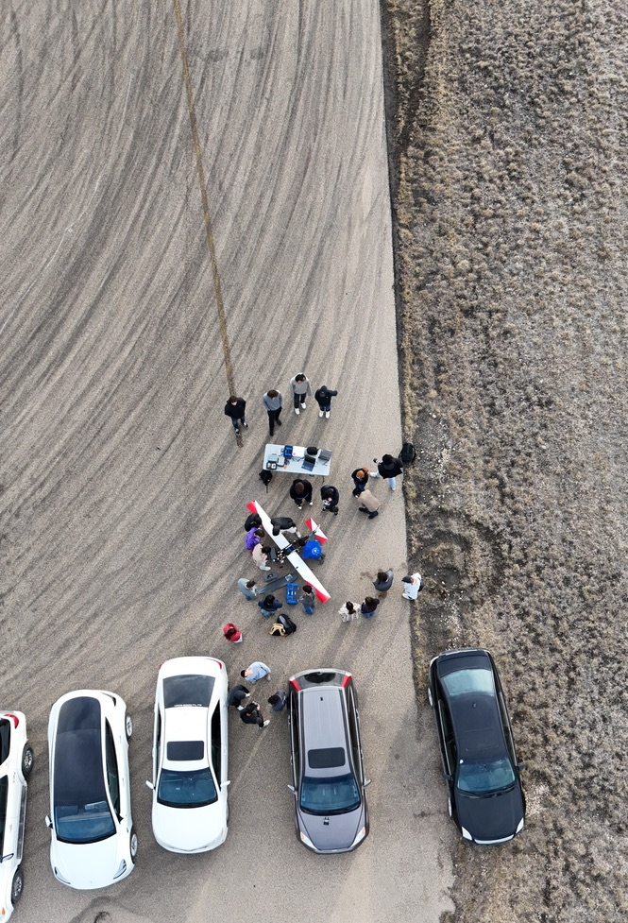
Schulich UAV
Lunch & Learn 2025
Notes:
Alexey

Slide 2
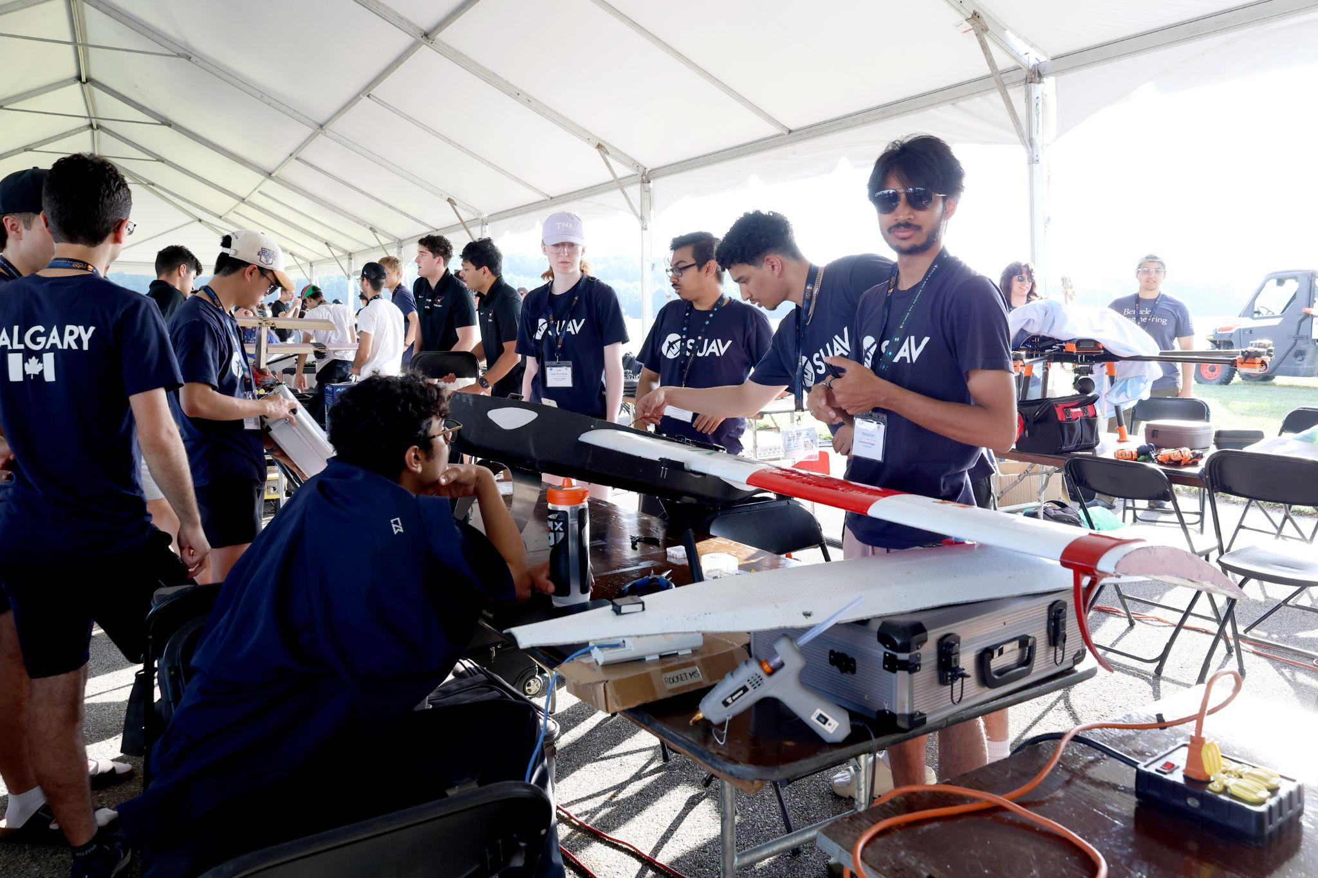
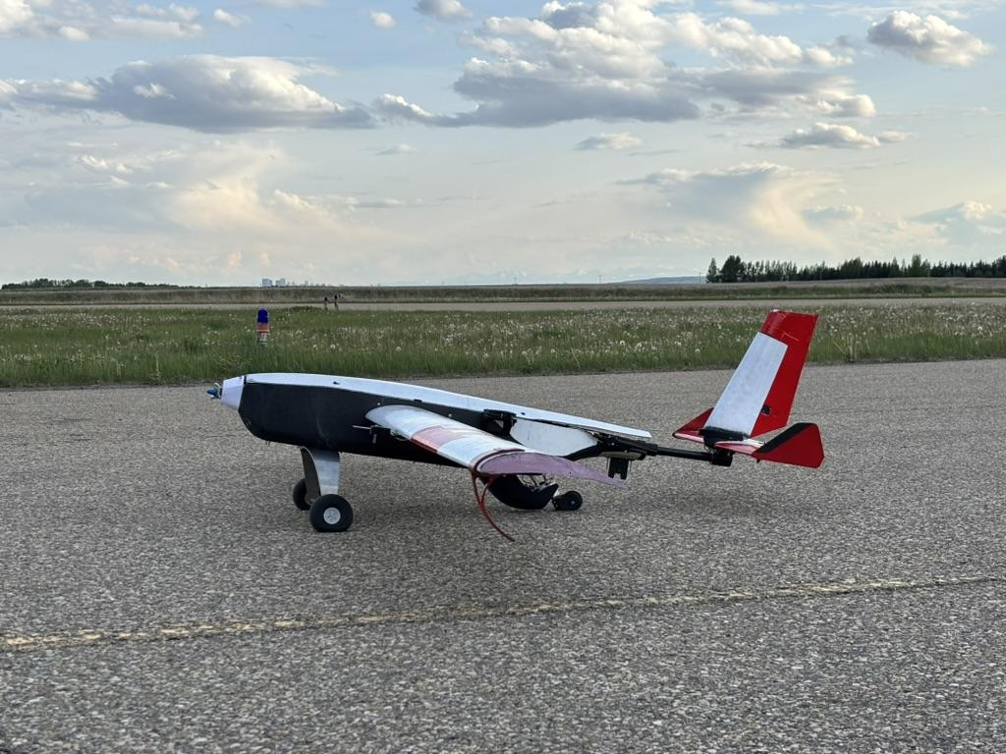
Today’s L&L
Introduction to Schulich UAV
Competition requirements
Aircraft
Custom GCS
Development challenges
Competition recap

Slide 3
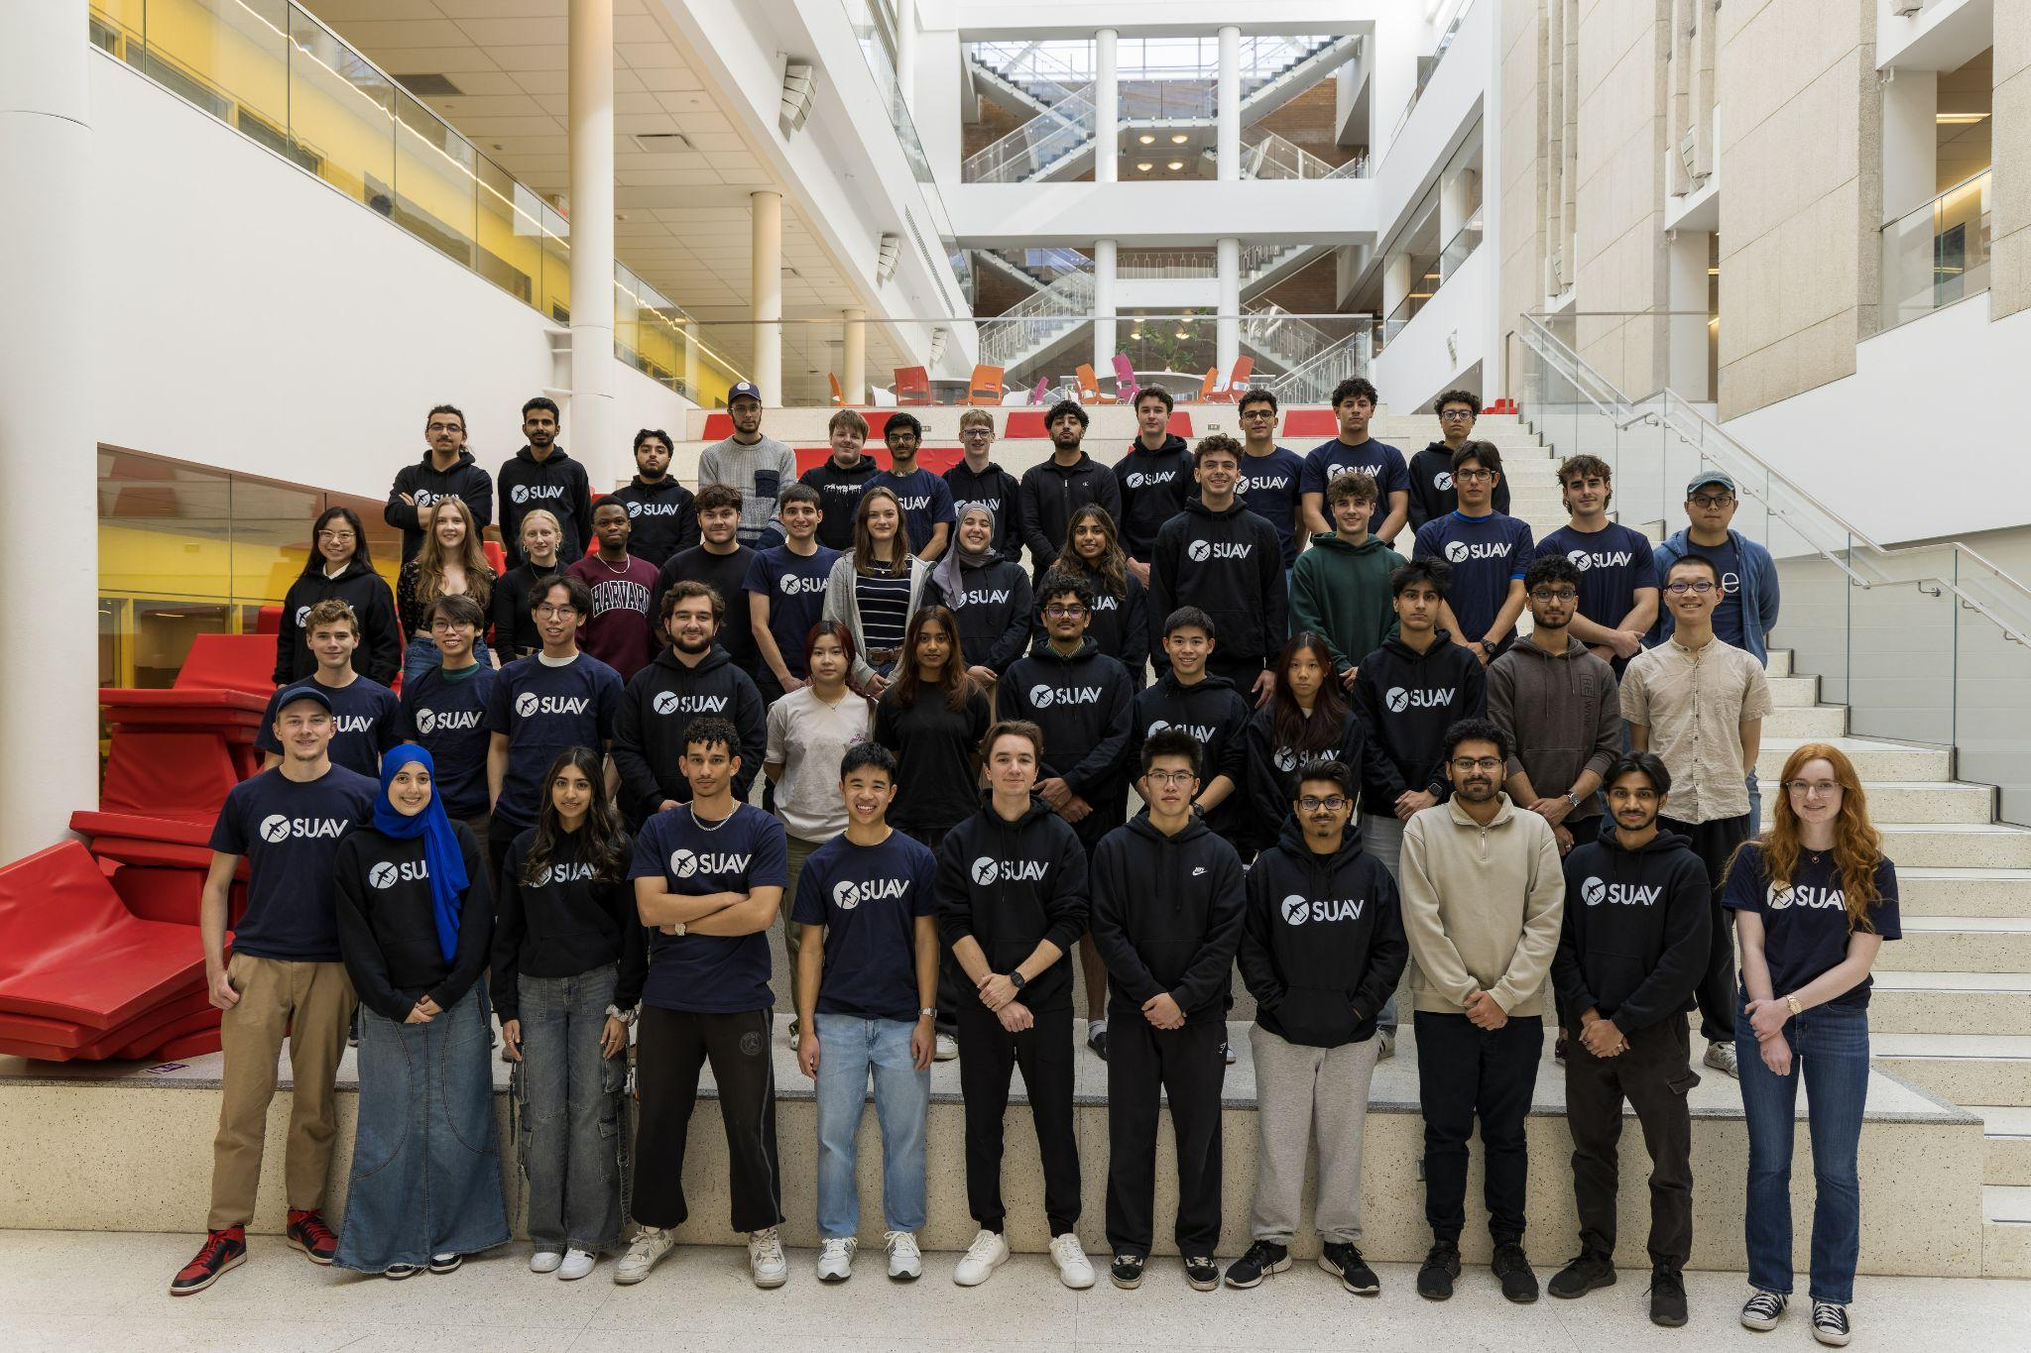
Our Team
Notes:
Alexey

Slide 4
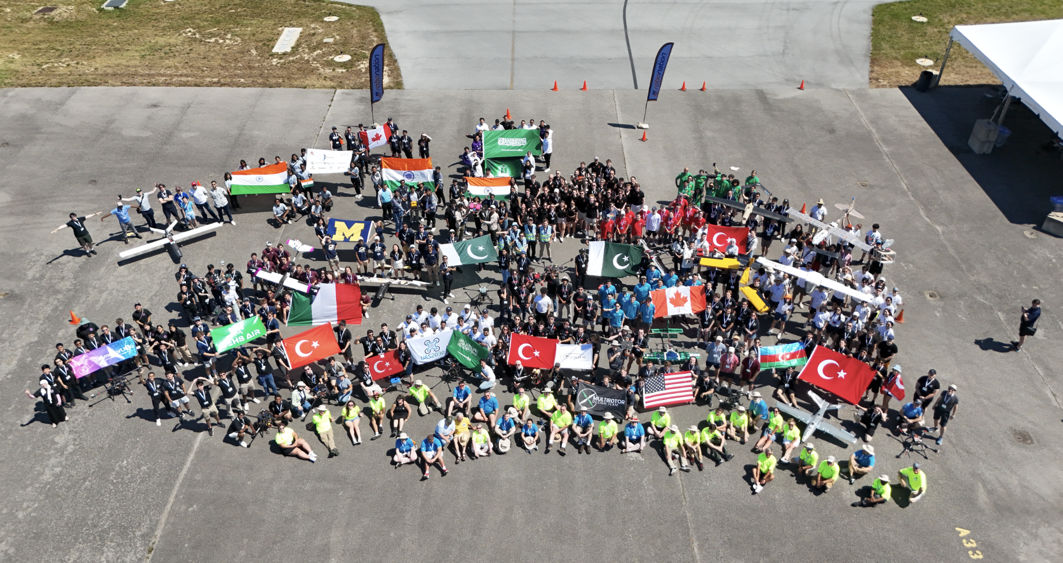
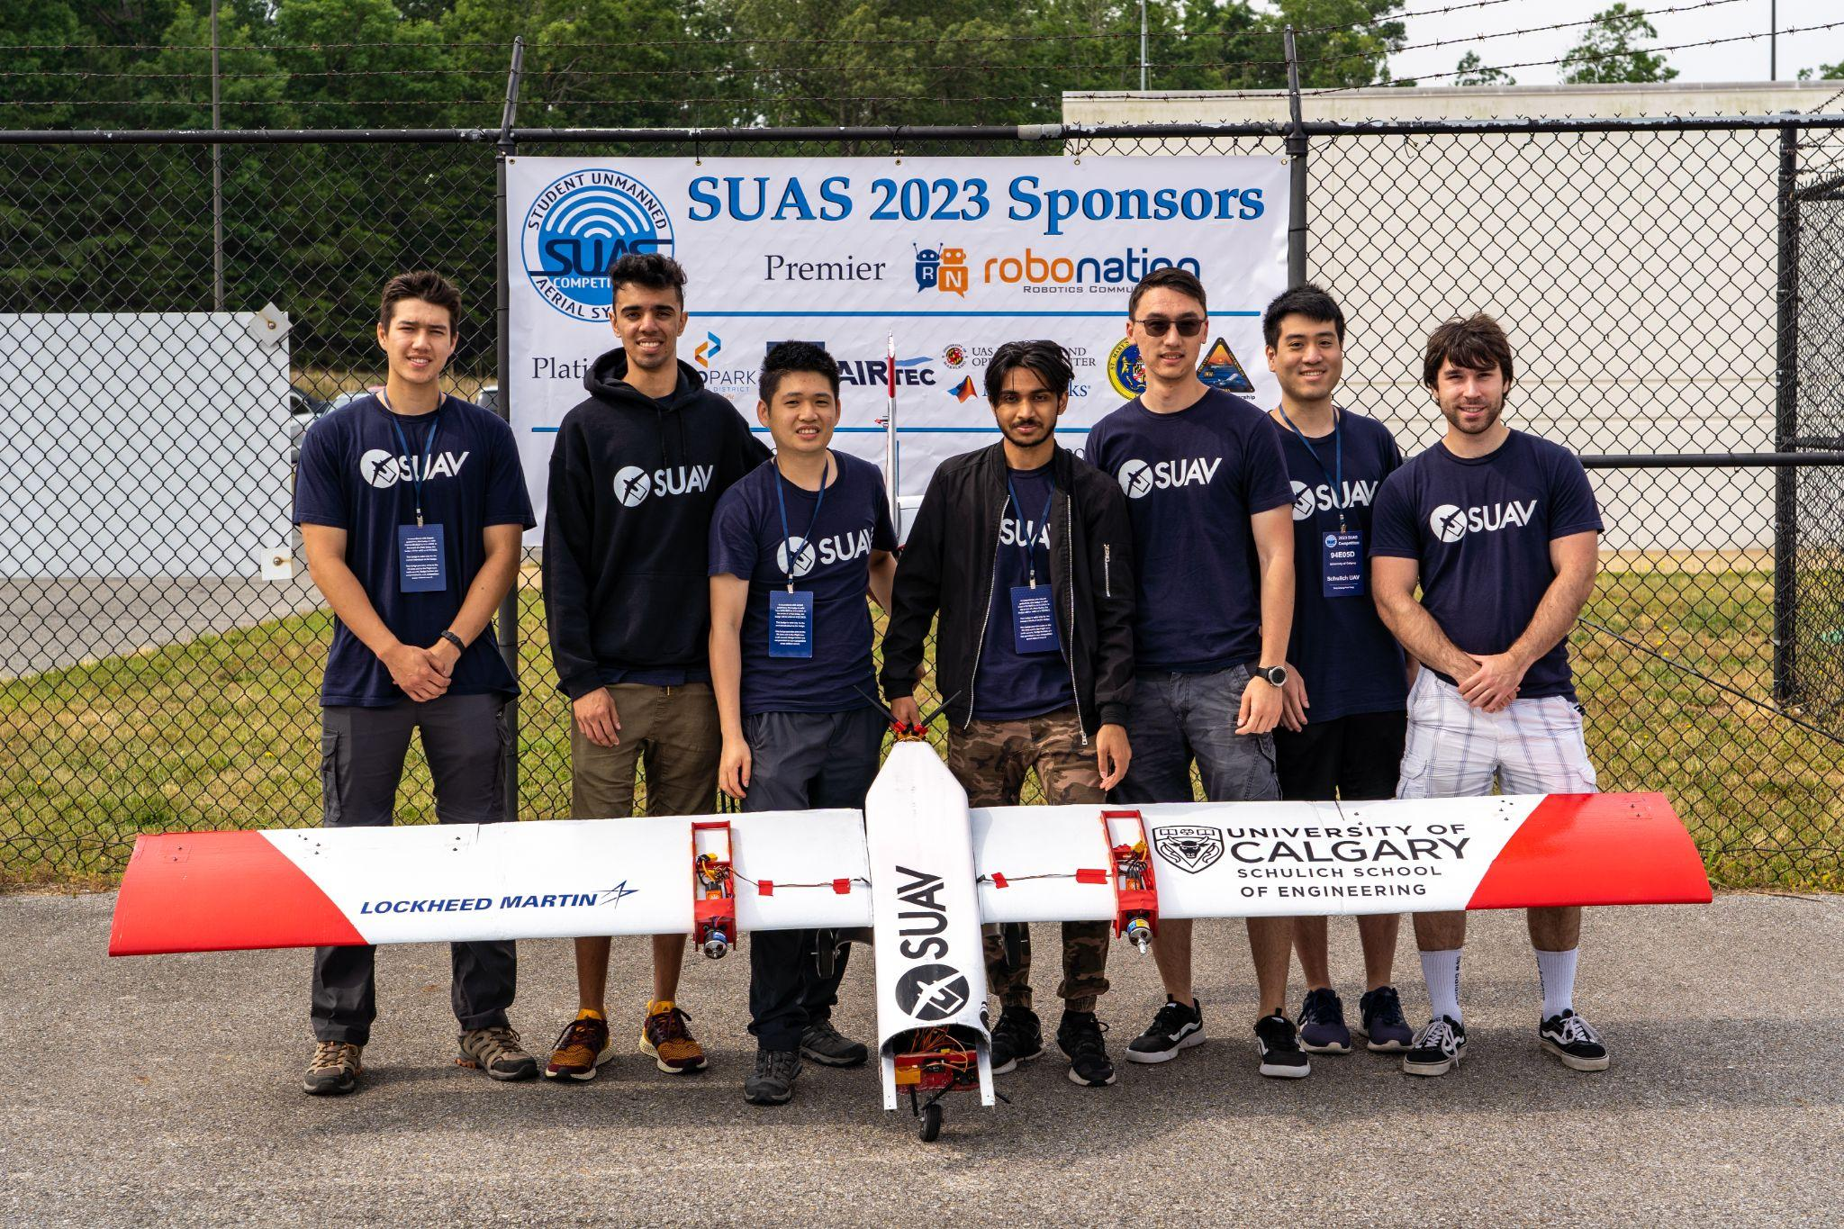
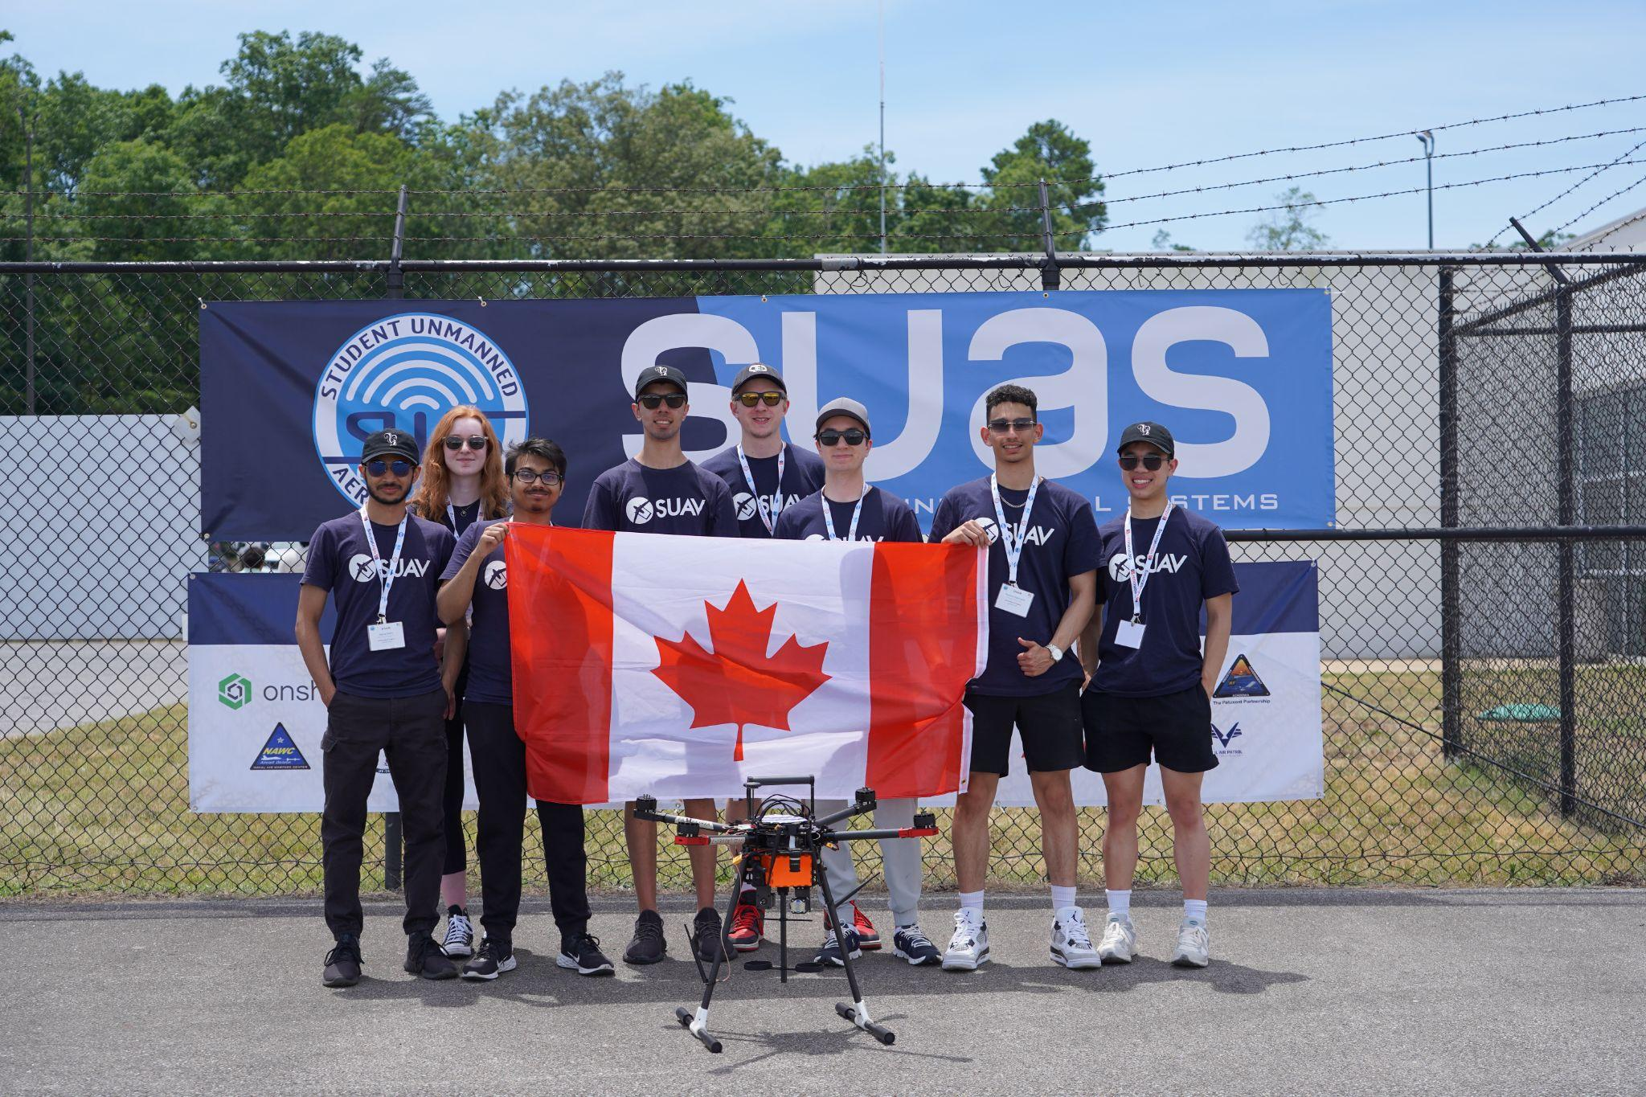
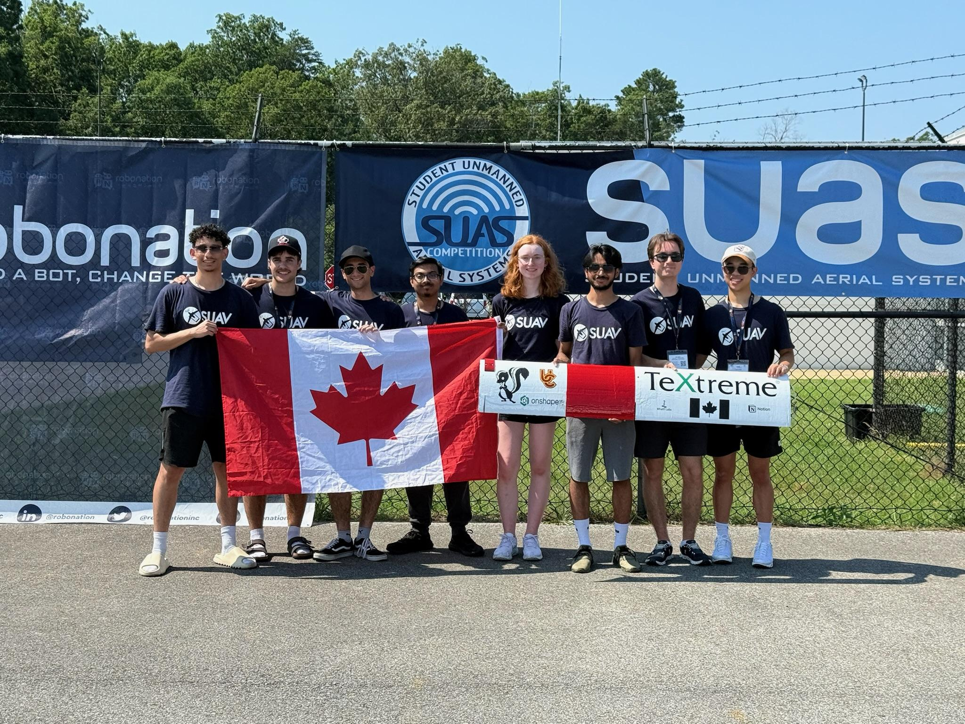

Competition - SUAS 2025
Largest student UAV competition in the world
(81 teams from 19 countries)
Designed to create interest in UAS to push students towards UAS technologies and careers
Notes:
Alexey

Slide 5
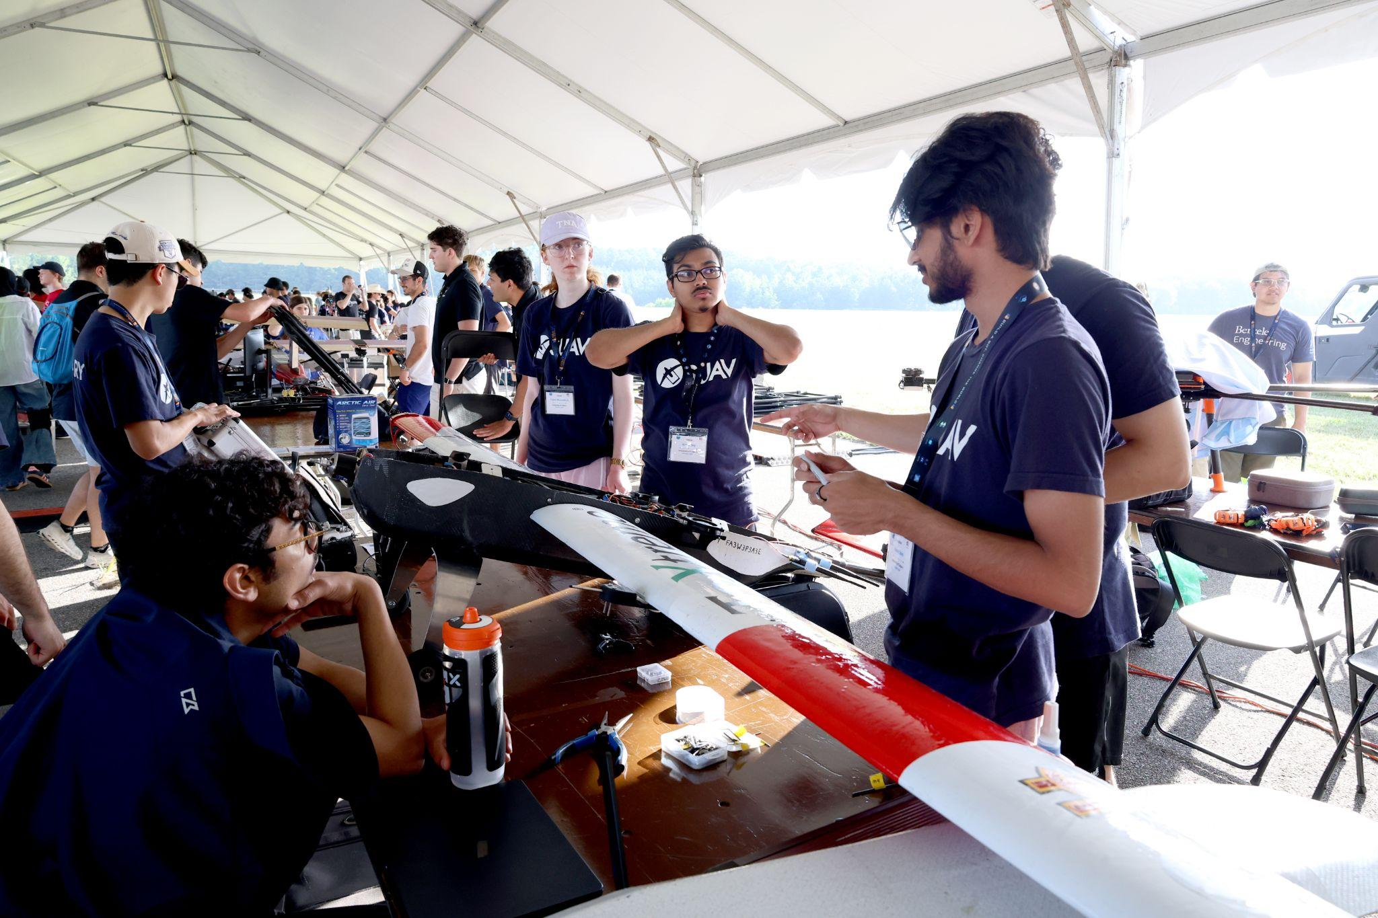
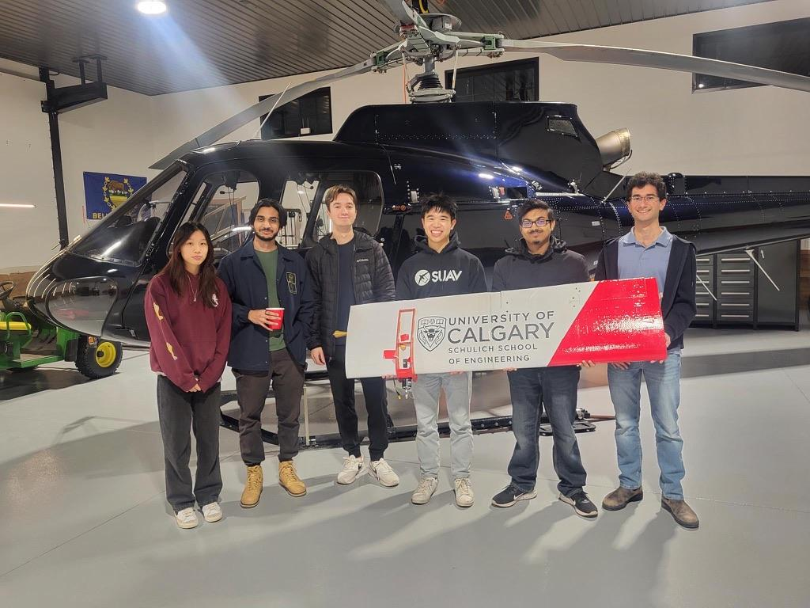
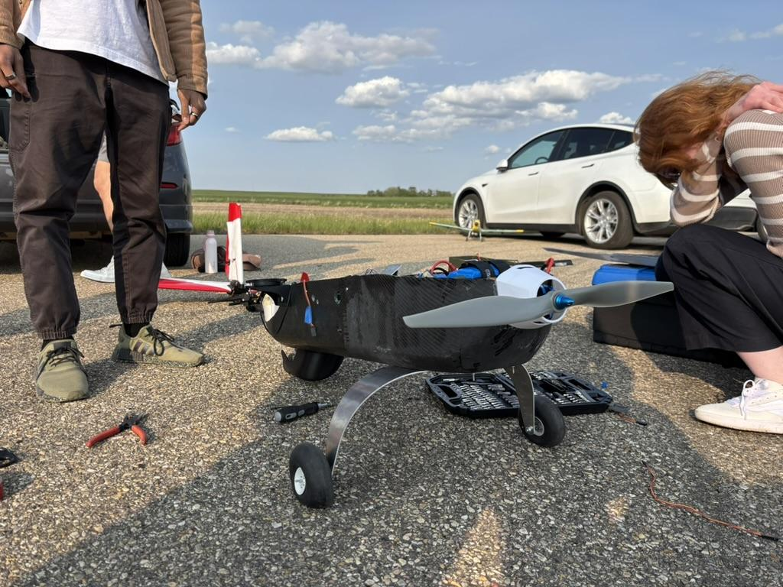
Design Goals & Submissions
Proof of Flight Readiness Video: Proof of flight
Technical Report: Design decisions & competition plan
Team Website: Team, sponsors, media, design, history
Mission: Fly 12 miles autonomously with mapping and payload drops
Notes:
Alexey

Slide 6
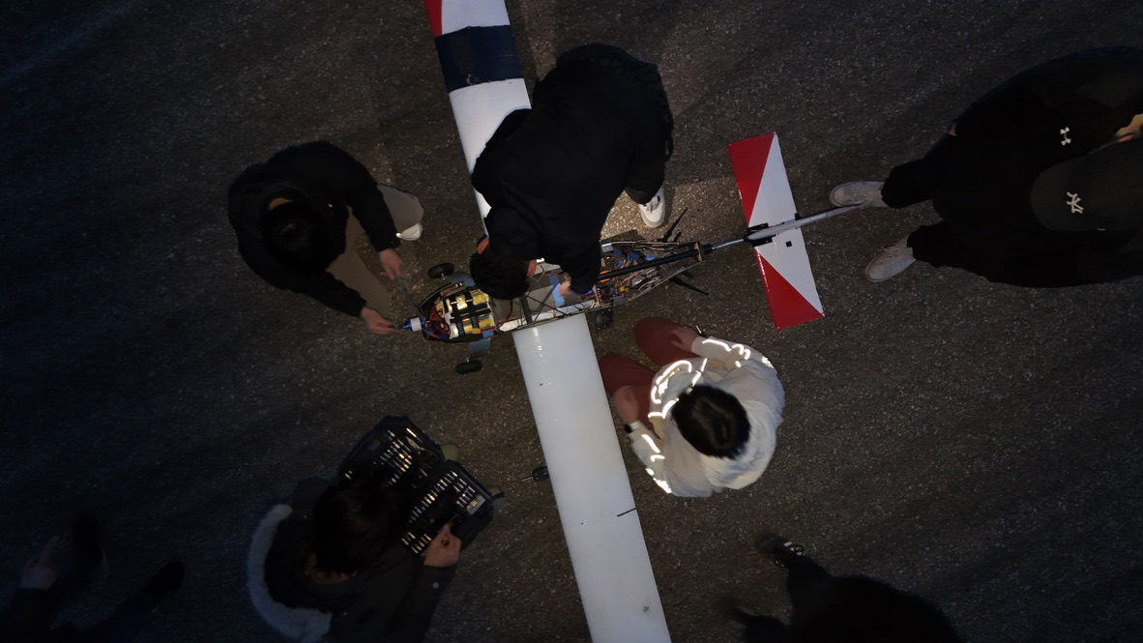
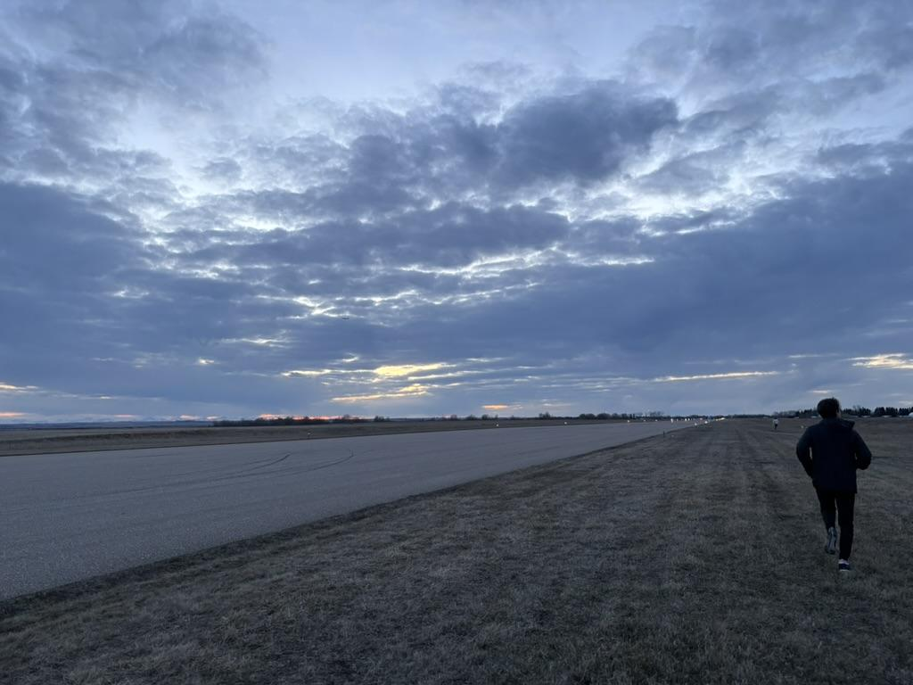
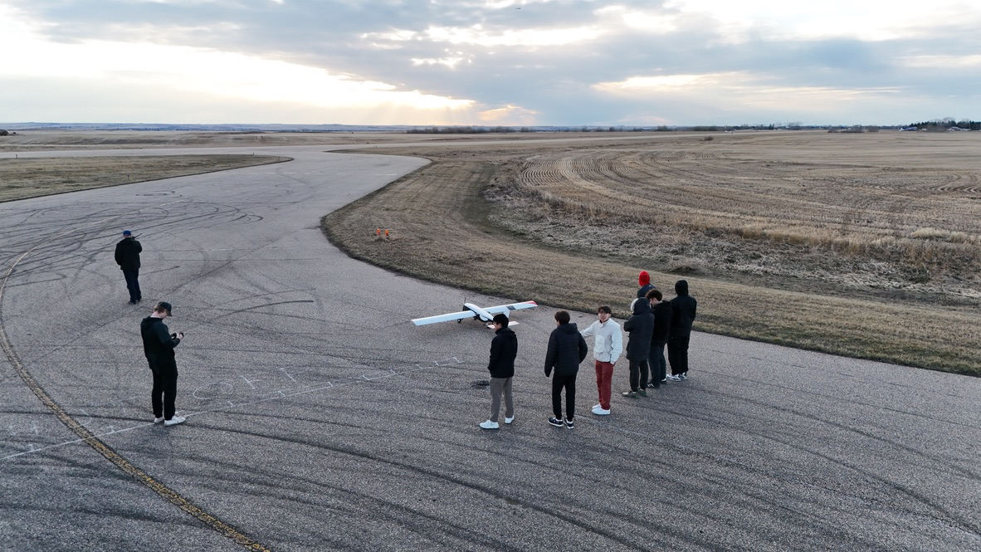
System Requirements
Fully autonomous
Maximum waypoint error of 50ft
Maximum turn radius of 150ft
Angle of climb/descent of 20 degrees
Minimum altitude of 75ft AGL, maximum altitude of 400ft AGL
Able to takeoff and land in runway 70ft x 500ft
Notes:
Haziq

Slide 7
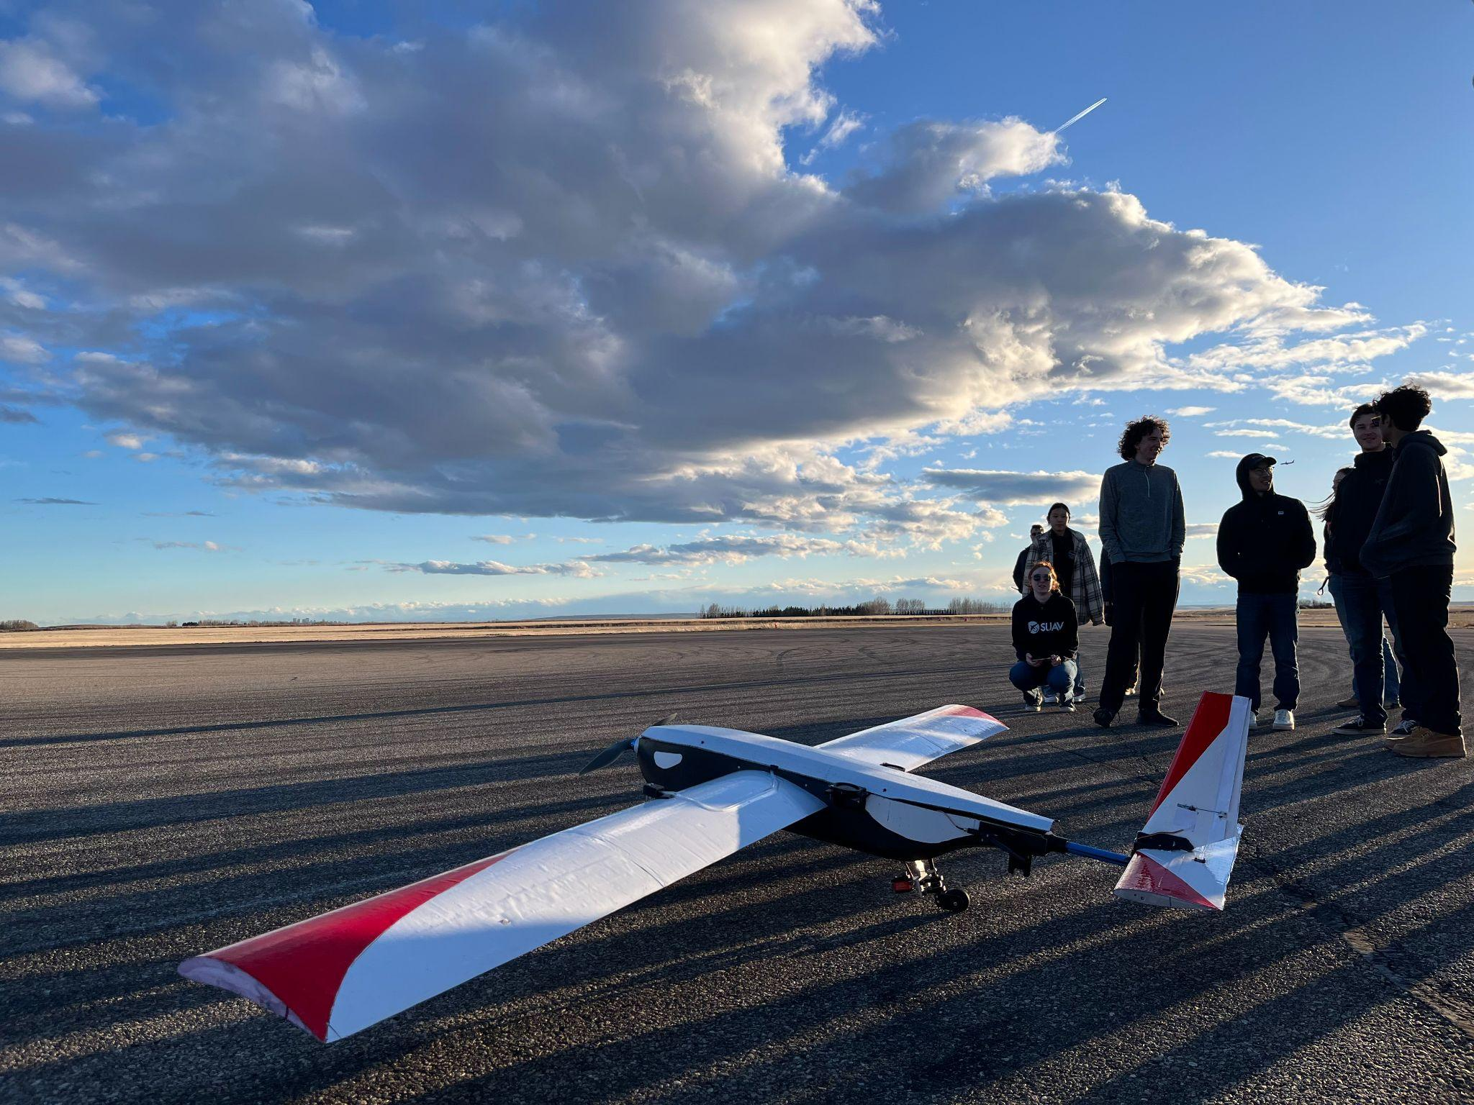
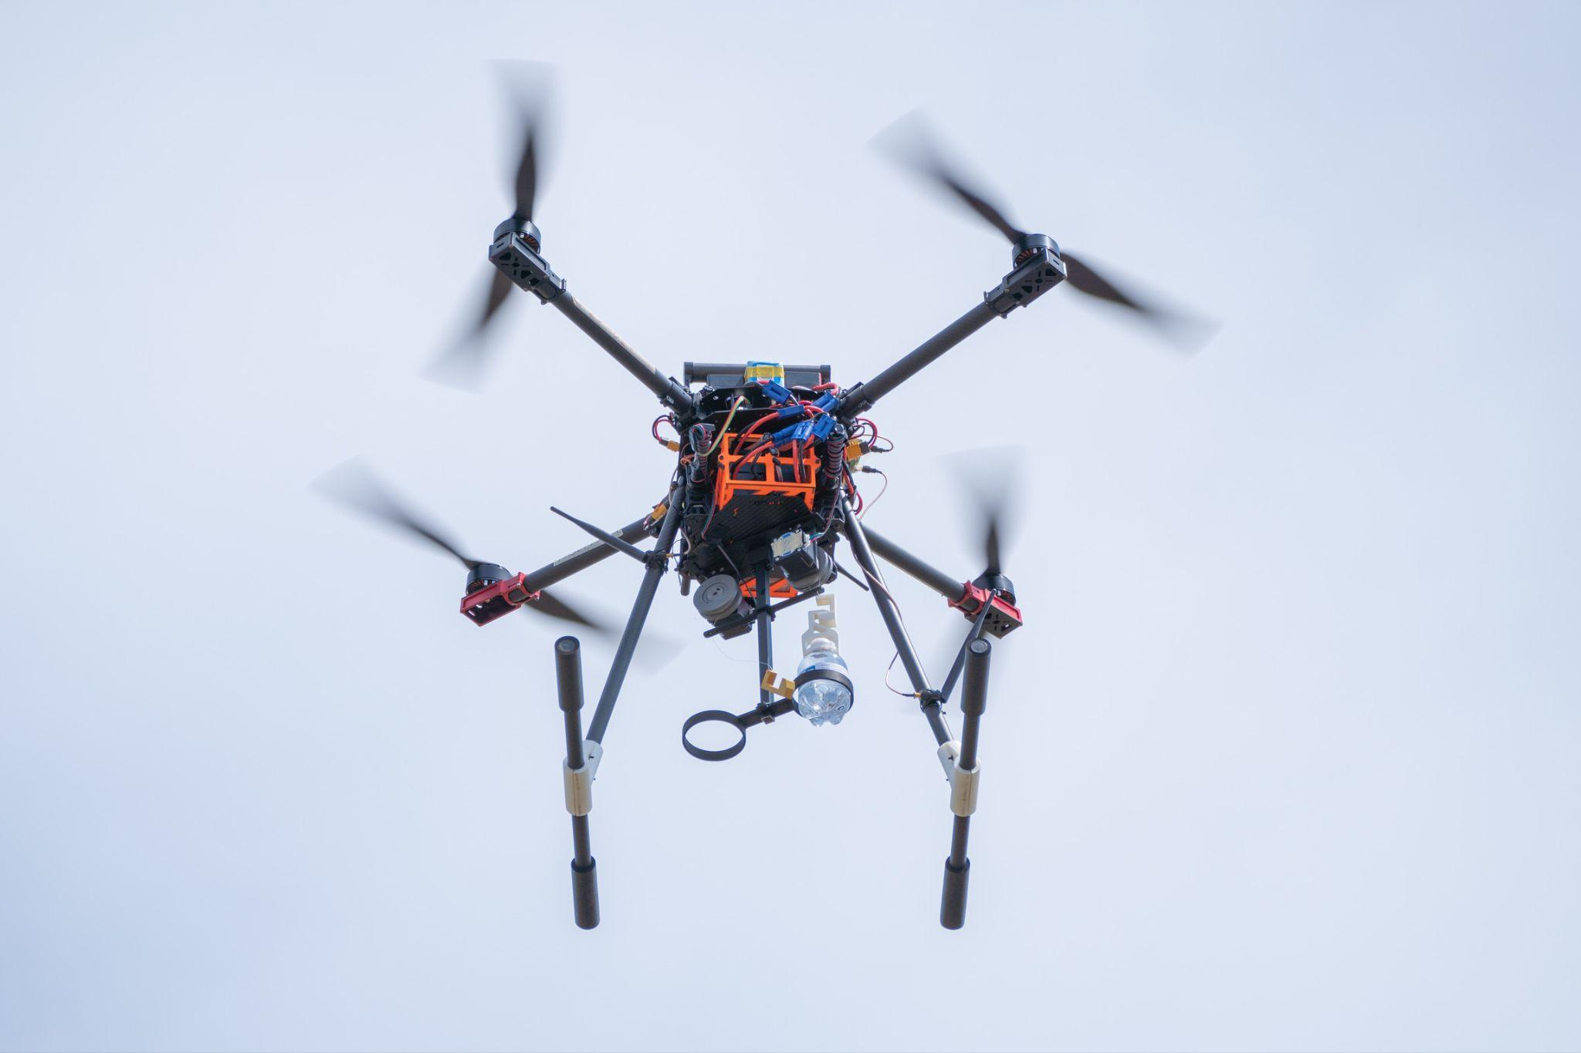
Fixed wing vs. Multirotor

Slide 8
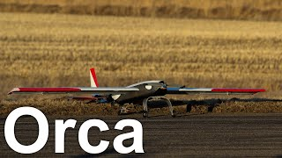
Orca

Slide 9
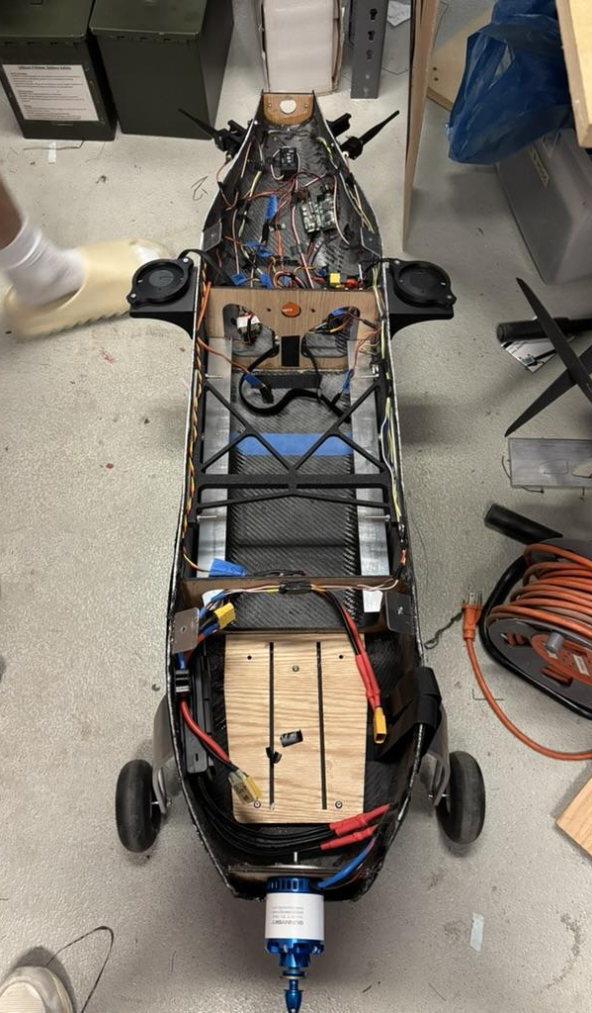
Schulich UAV
Design
Notes:
Alexey

Slide 10
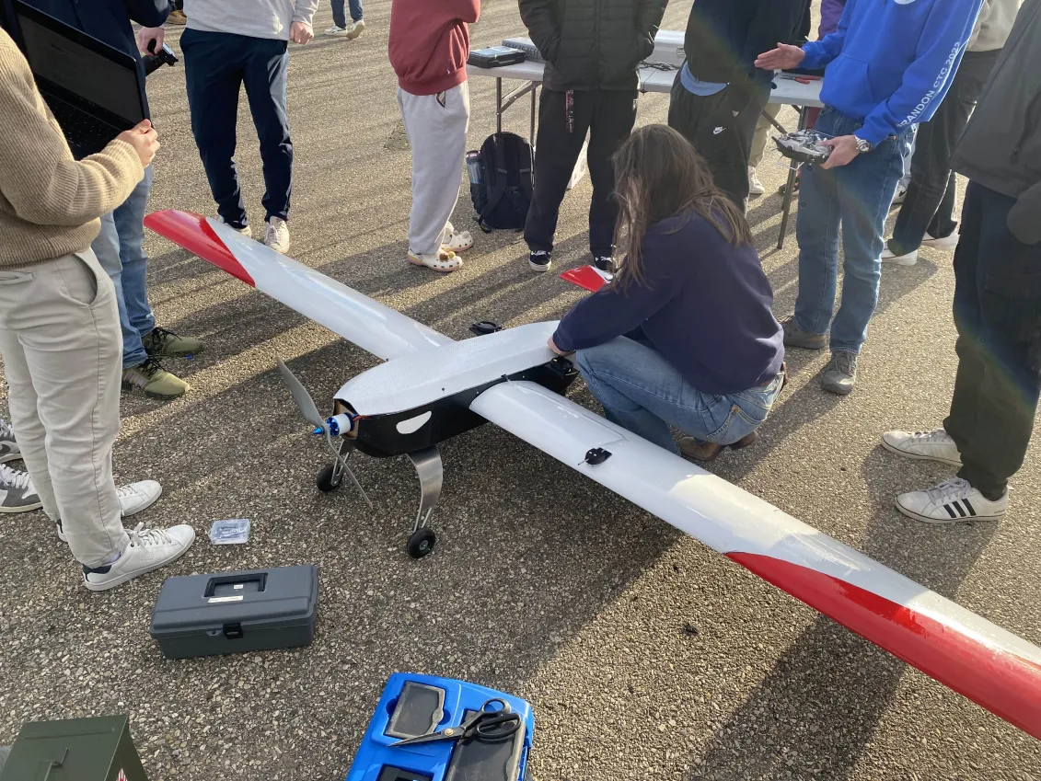
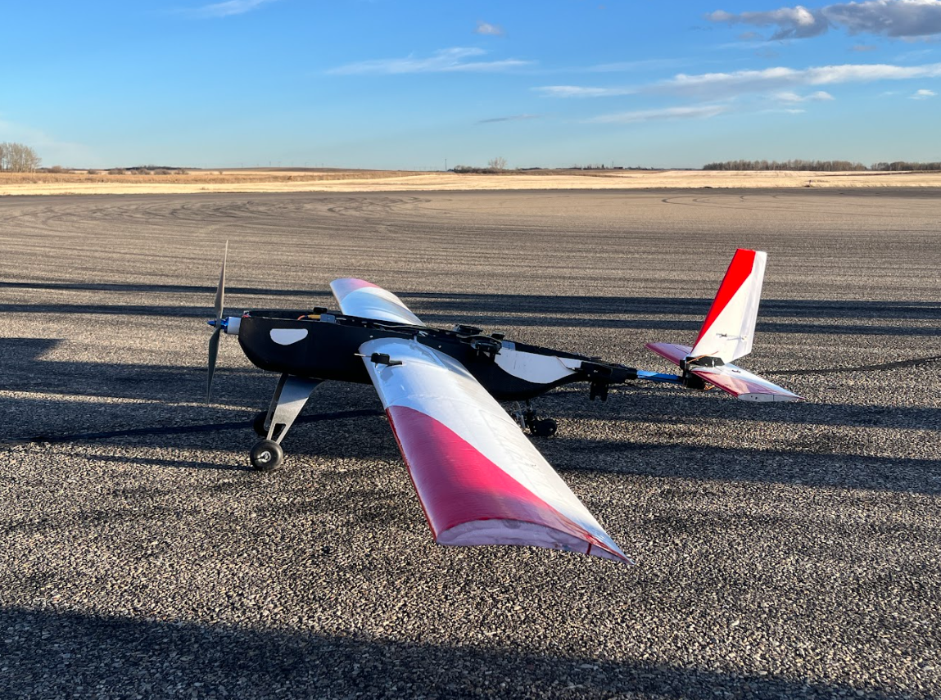
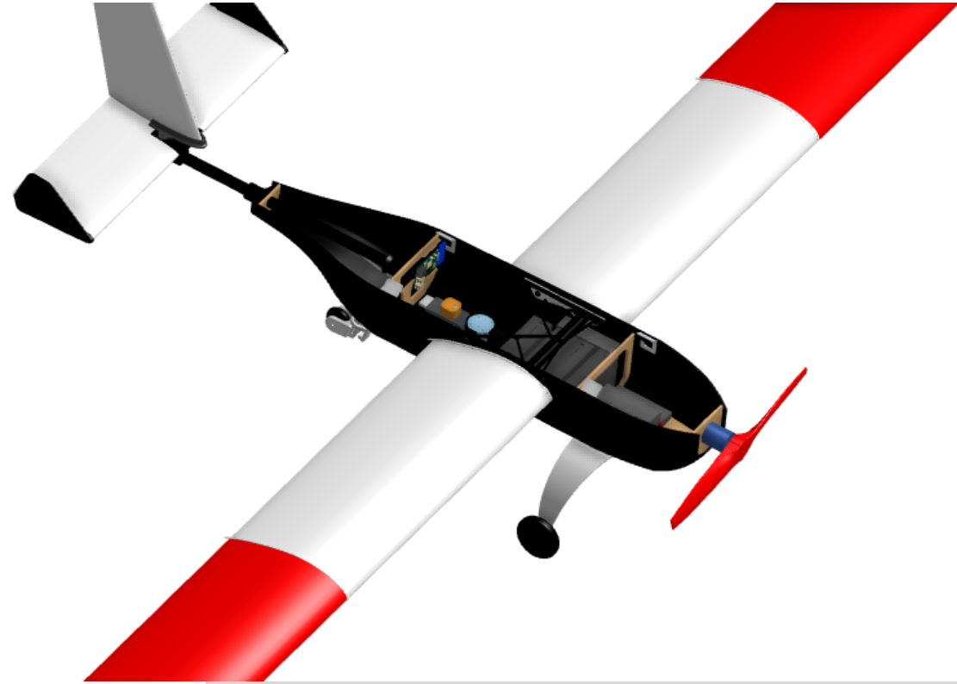
Mechanical
Overall Design Goals
Simplistic
Iterable
Easily-repairable
Ease of electronic access
Quick assembly time
Slow cruise speed
Notes:
Alexey

Slide 11
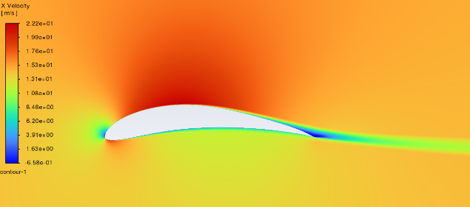
Aerodynamic Design
Goal: optimize speed for payload delivery and imaging
Design Constraints:
Payload mass
Flight profile – imaging, payload drop, and cruise speed
Manufacturability
Notes:
The design of Orca began with an aerodynamic analysis, starting from a desired cruise speed for which we would be able to feasibly conduct payload drops and imaging at. Alongside this cruise speed, we also approximated the final mass of the aircraft based on a linear regression from historical aircraft, using the payload mass. This led us to determine other design elements such as airfoil and tail sizing
What we used to 'do our analysis' – we used XFLR5 for comparative analysis of airfoils with plots like lift coeff vs AoA, L/D vs AoA etc.
The picture in the slide is from ANSYS, and we used it to verify existence of flow separation at our cruise and low speeds
General design process:
Started from a linear regression to predict the mass of the aircraft, based on previous aircraft masses & the mass of the payload required
Chose a desirable cruise speed for imaging and payload deployment
Developed the wing and tail sizes based on these constraints
Other design constraints:
Manufacturability – we were limited in aerofoil airfoil shape that we would be able to hotwire cut out of foam – too narrow of a trailing edge would be too delicate, too much camber would be difficult to cut
Transport size – we would have to ensure that the wingspan would feasibly be able to fit on a plane for transport

Slide 12
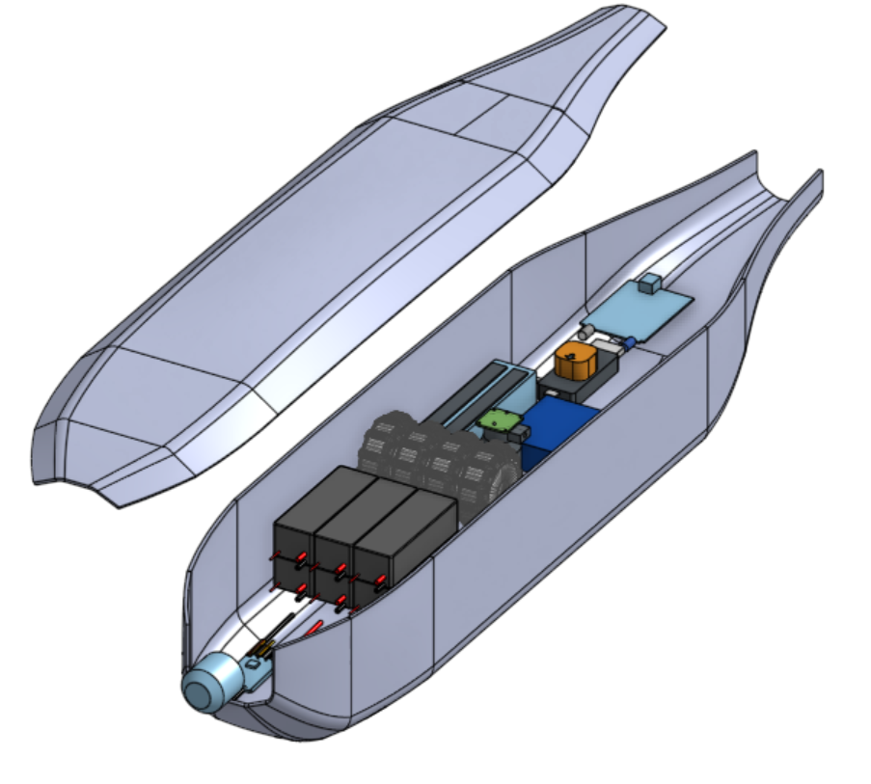
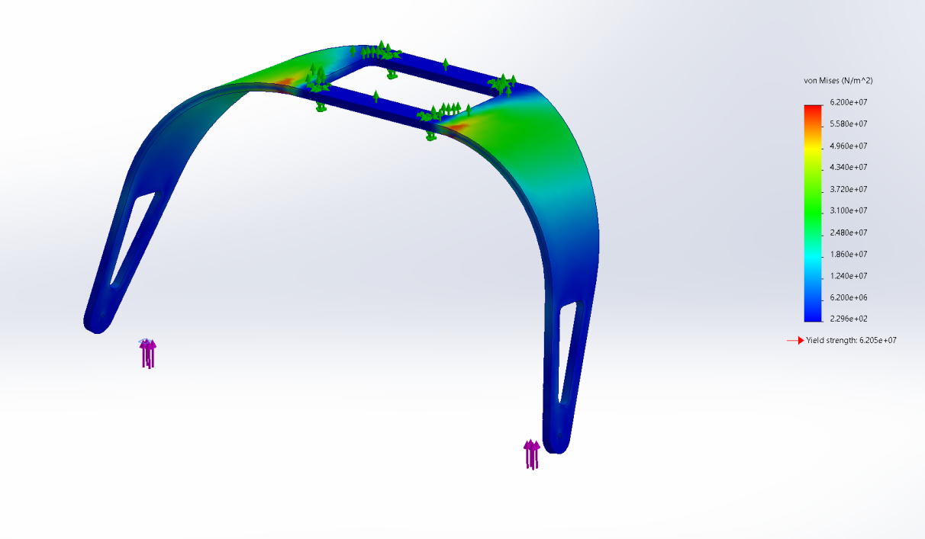
Manufacturing Design
Custom-designed & manufactured fuselage to house payloads and electronics
Emphasis on ease of electronic access and setup
Notes:
Alongside our aerodynamic design, we also designed and manufactured structural elements of our aircraft, such as our fuselage, internal structures, and landing gear.
Our fuselage was completely custom designed to house all of our electronics and payload

Slide 13
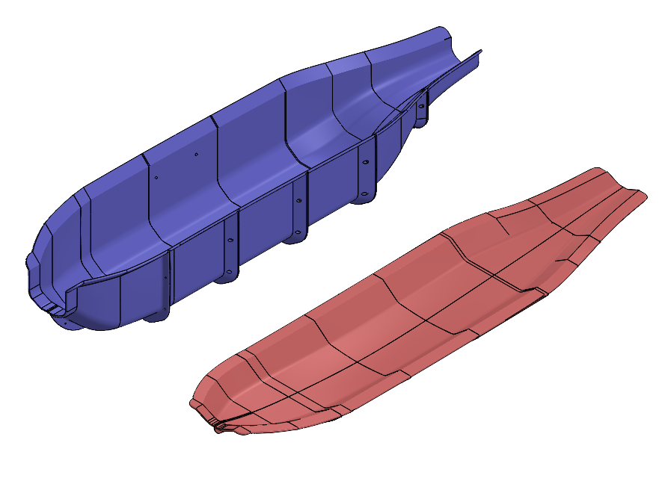
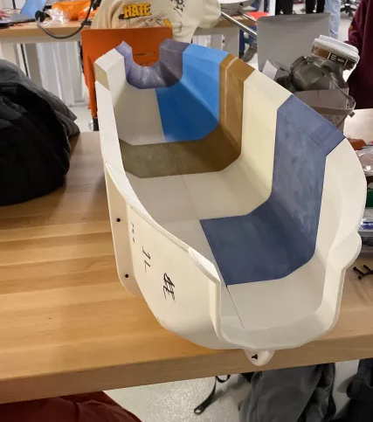
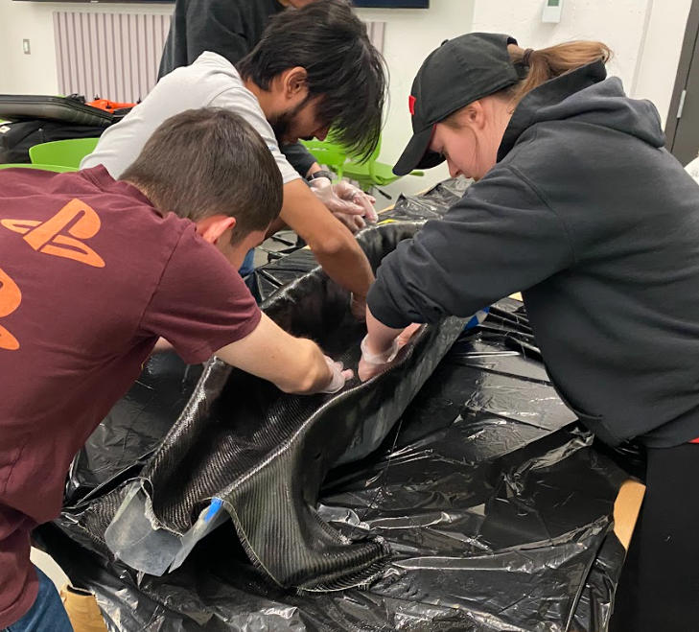
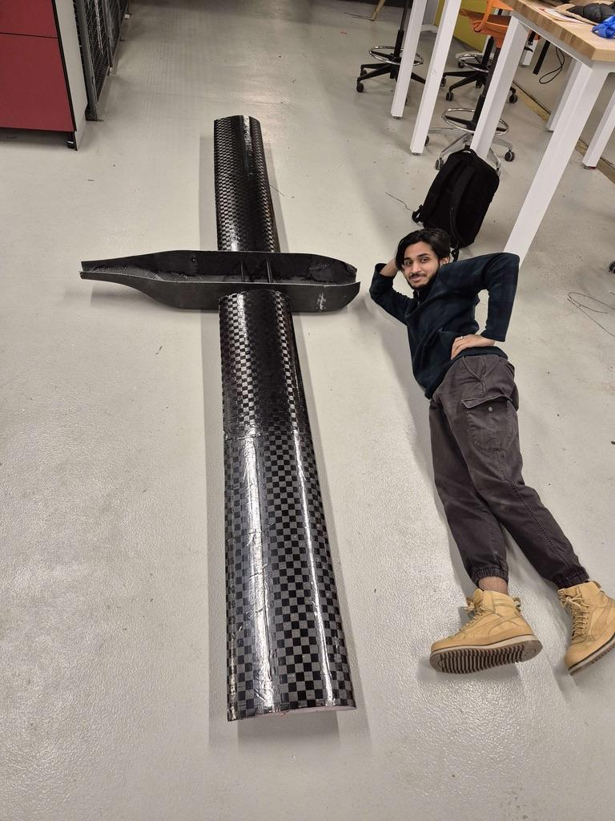
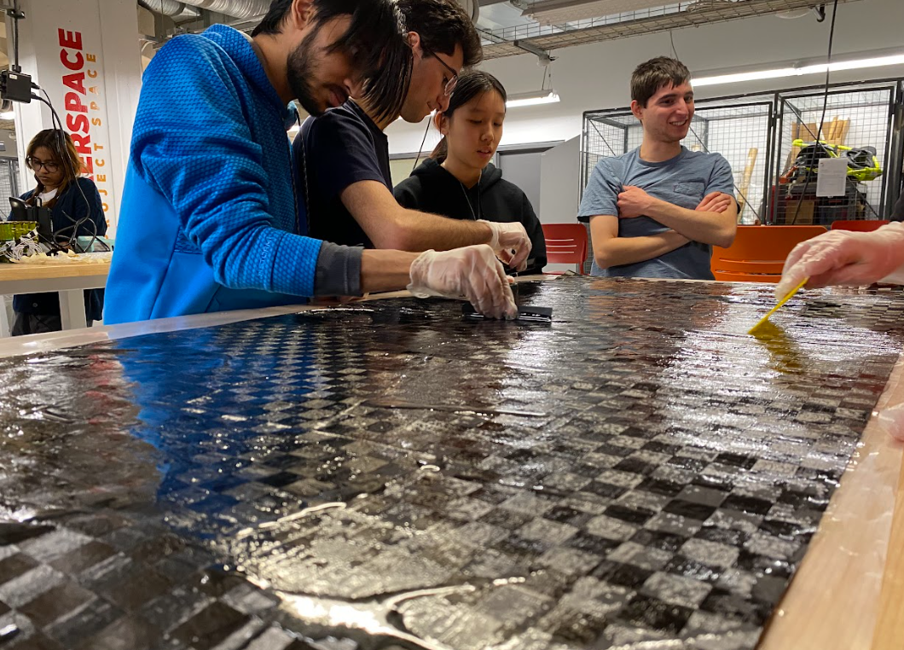
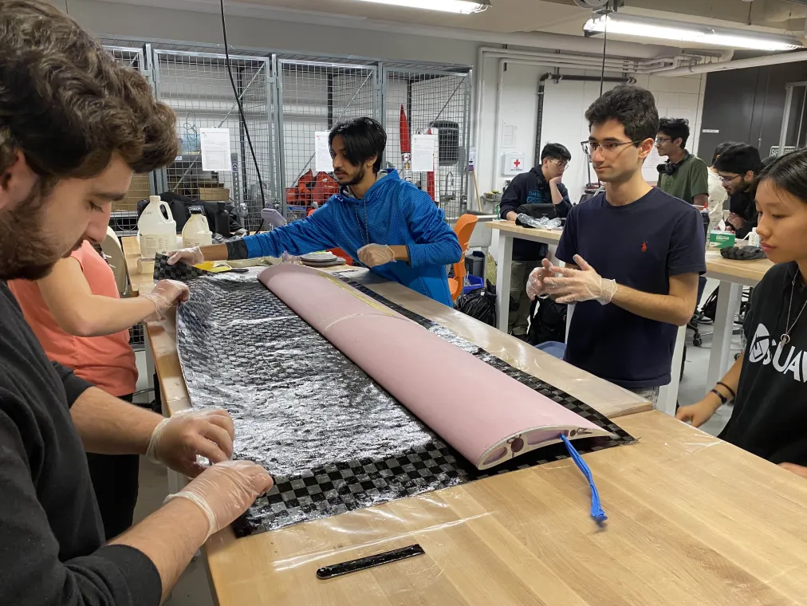
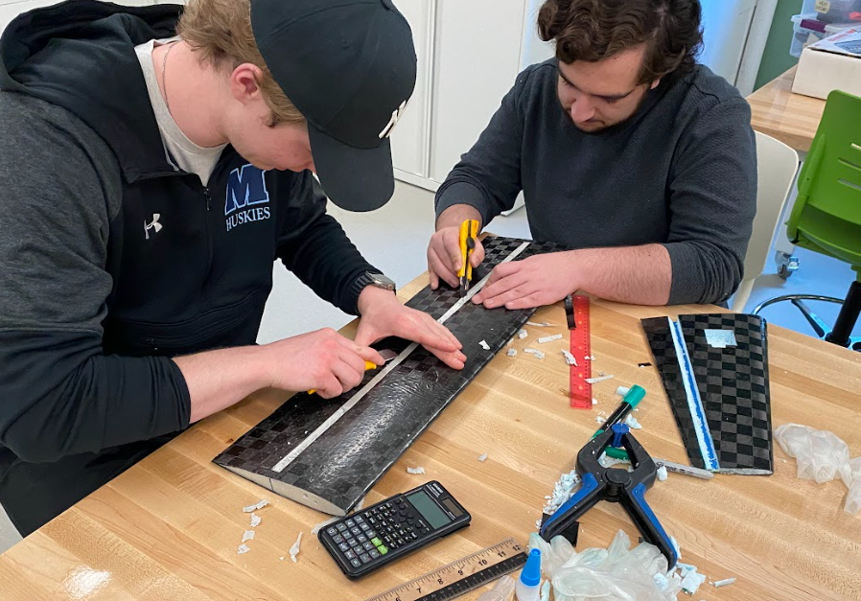
Manufacturing Design

Slide 14
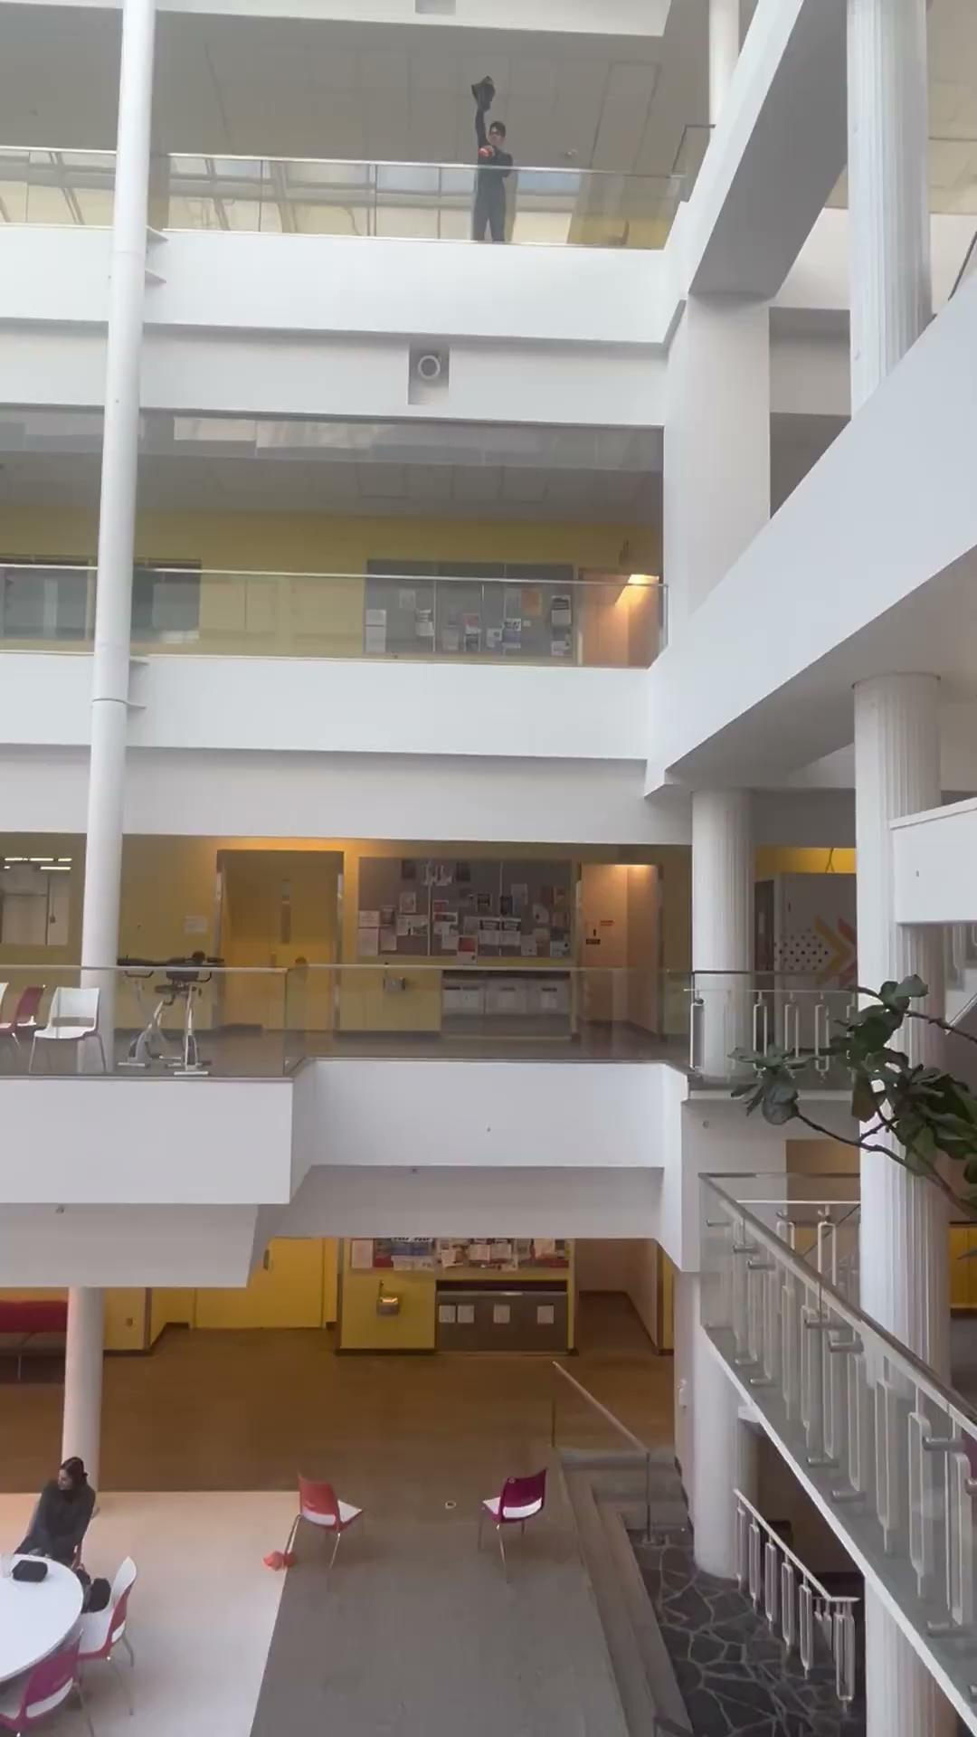
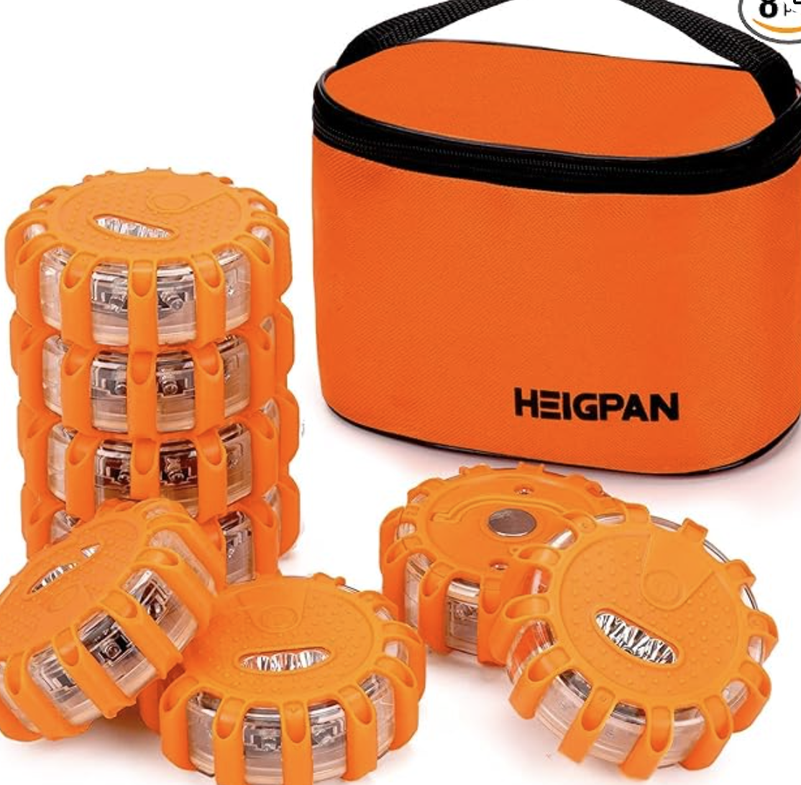
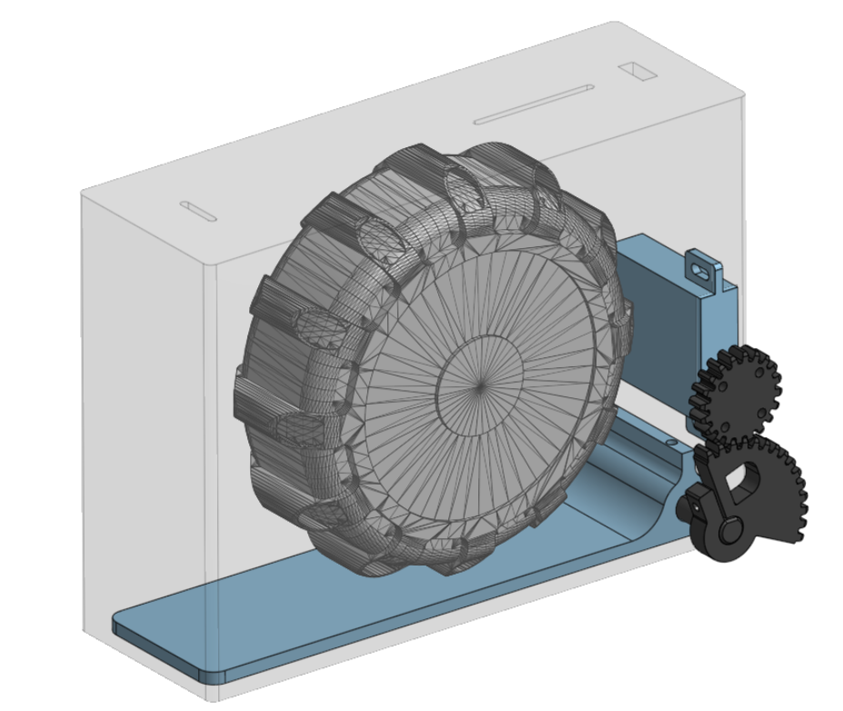
Payload
Based on fixed-wing aircraft, created a parachute payload deployment mechanism
Parachute folding tests to determine slowest release
Rapidly iterated payload bay designs
3D printed gear mechanism attached to motor
Notes:
Based on our fixed wing aircraft, the most feasible payload deployment method would be some kind of parachute.
Other release mechanisms considered:
Gliders
Delayed parachute release, with some kind of electronic mechanism on it to delay the opening of the parachute
Based on competition rules, the payload could have some kind of electronic on it, it just could not be controlled manually
However, ultimately, for simplicity sake, we decided to use a traditional parachute tied to the payloads

Slide 15
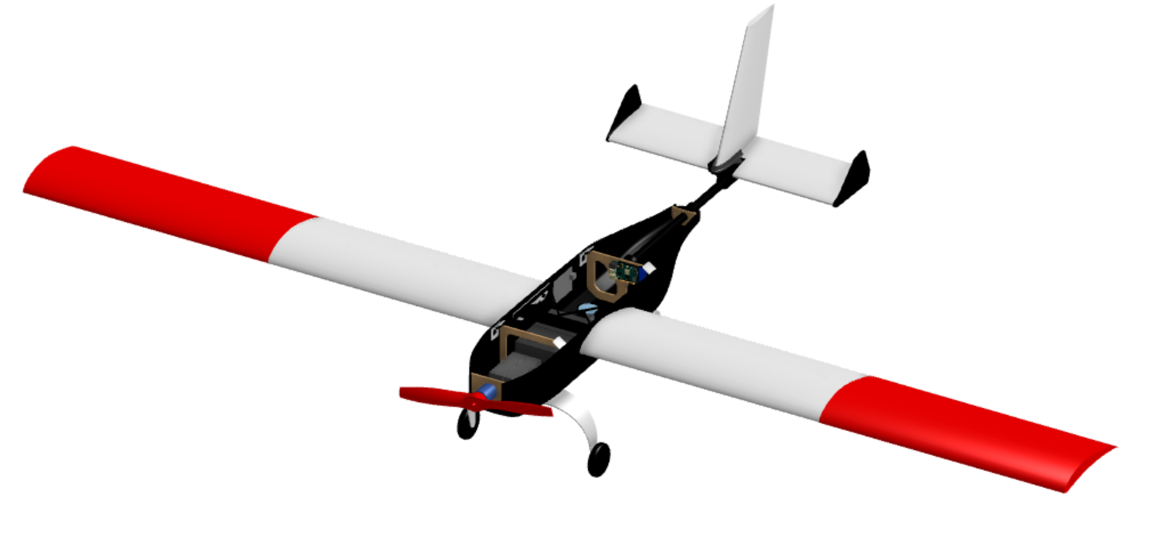
Final Aircraft
Carbon Wrapped Foam Core Wings
Custom Carbon Composite Fuselage
Payload Bays
Laser Cut Wood Bulkheads
Custom Aluminum Landing Gear

Slide 16
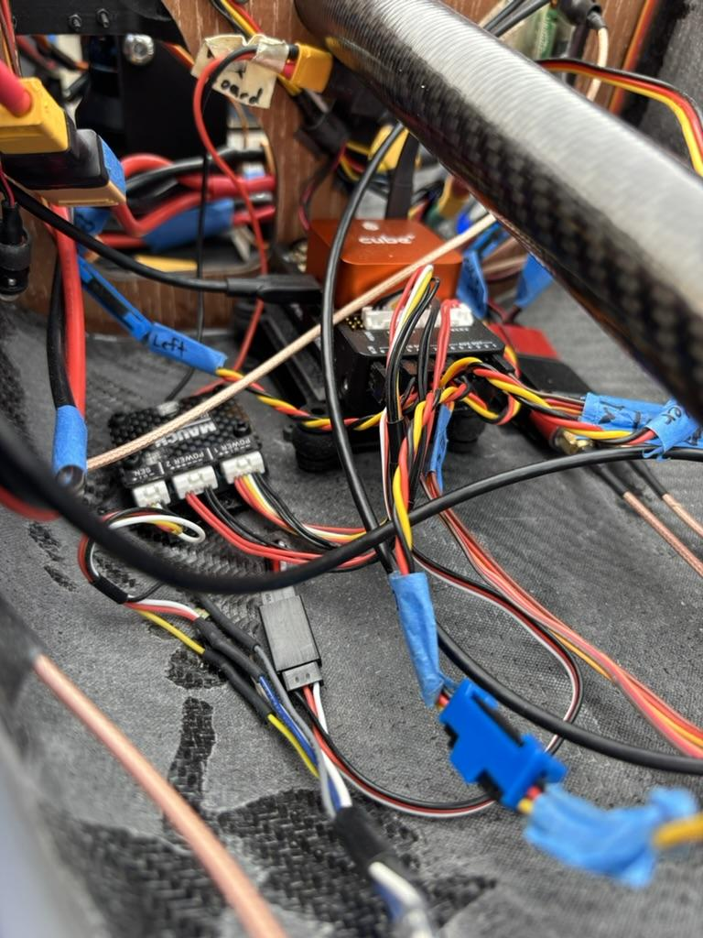
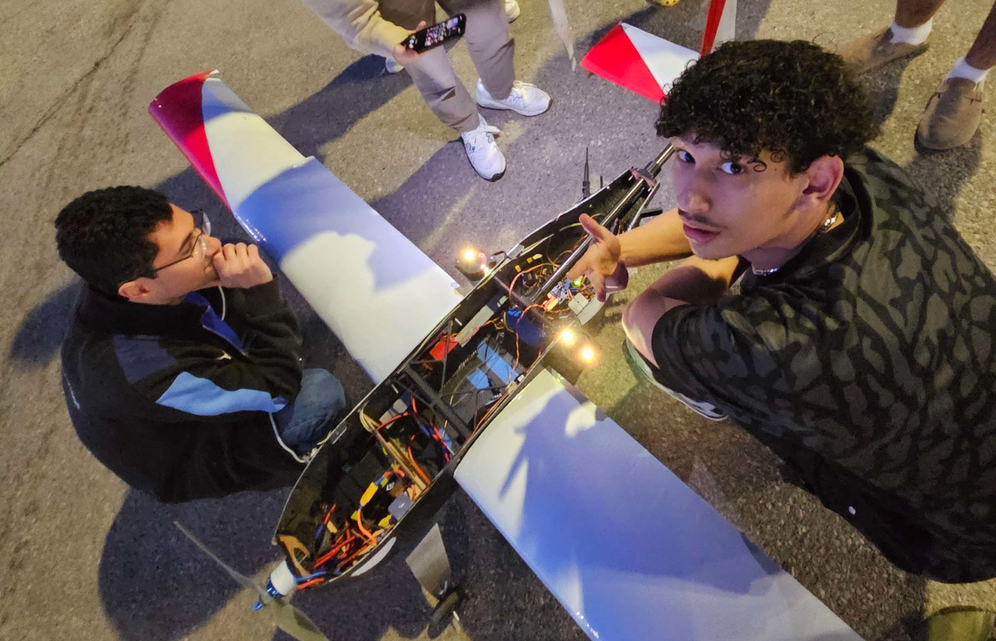
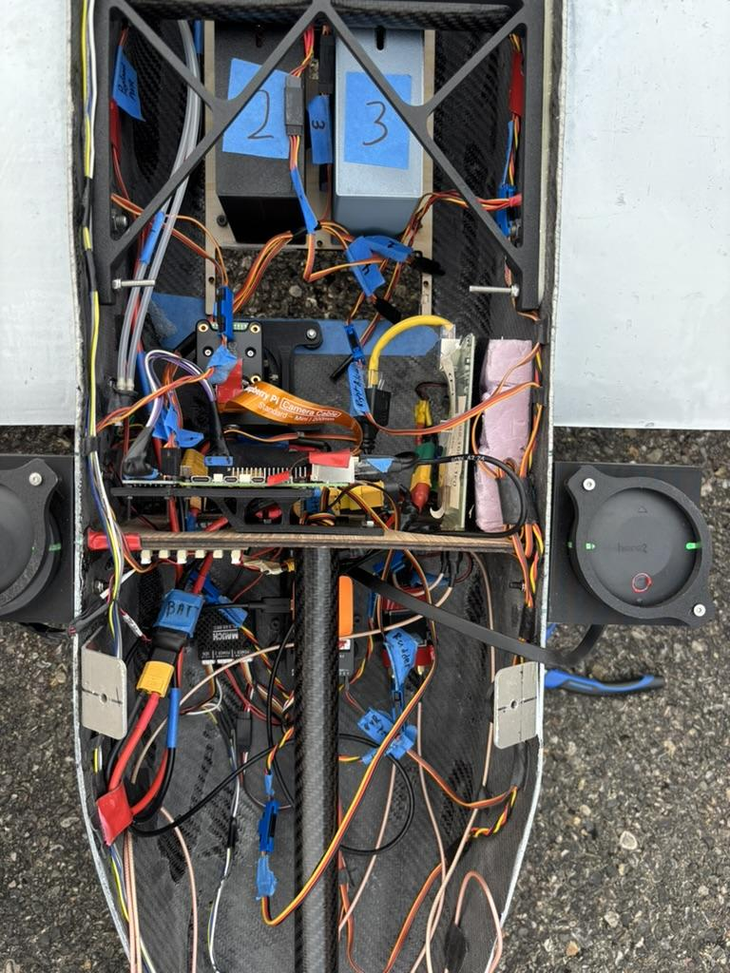
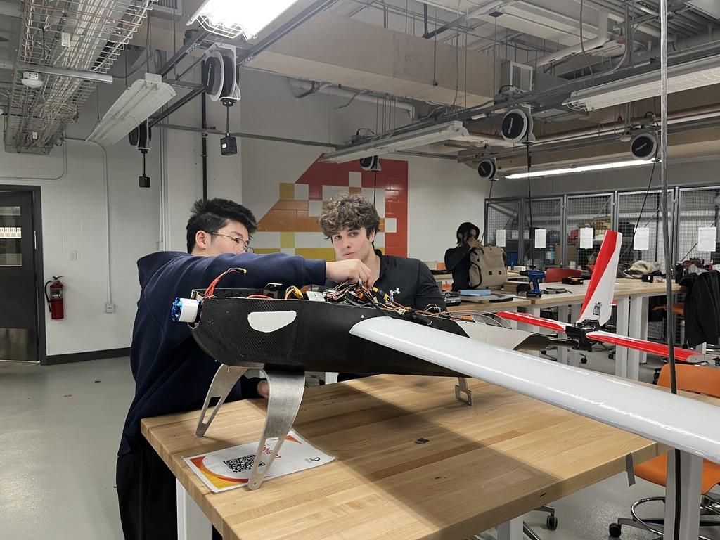
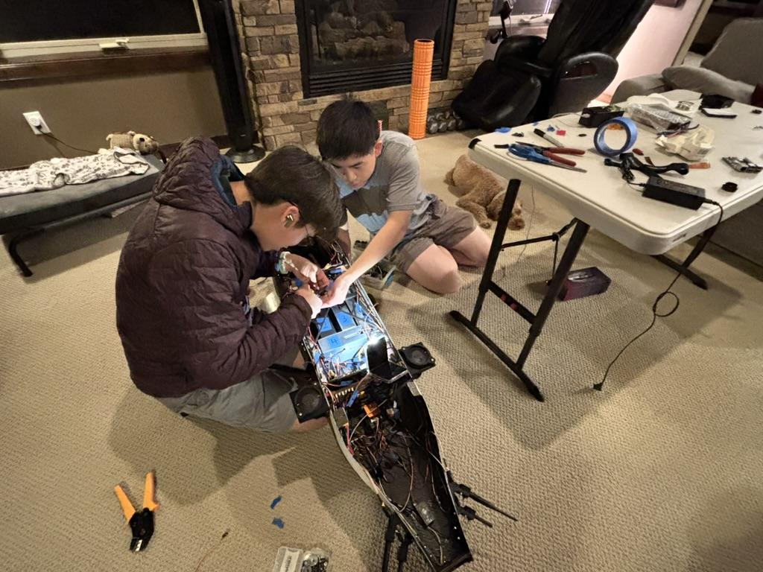
Electrical (split this into however many slides)
Notes:
Alexey

Slide 17
Electrical shii (DELETE LATER)
Power distribution systems
Battery selection and configuration
BECs
Control systems
OrangeCube + Sensors
ESC
Comms systems
Radios

Slide 18
Power
Balanced flight range with weight constraints
Opted for two battery packs, one for the motor and one for the avionics
Two independent batteries
LiPo batteries, 6s4p, 22.2V, 32,000mAh
Discharge quick enough current to motor ~ 80A peak

Slide 19
Thrust Jawn

Slide 20
Autopilot and Sensors?
Designed around Orange Cube
Pixhawk flight controller
Dual GPS (blend)
Pitot tube

Slide 21
Communication Systems
RFD 900 sik radios

Slide 22
Electrical Design

Slide 23
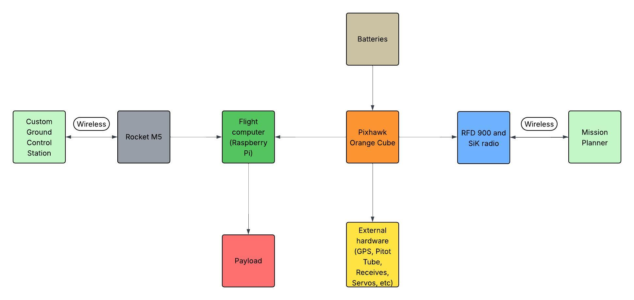
Electronic Ecosystem

Slide 24
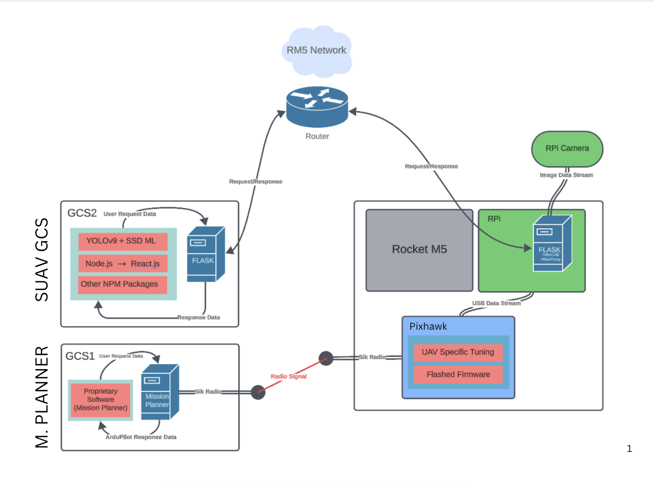
Software System Design
Notes:
Alexey

Slide 25
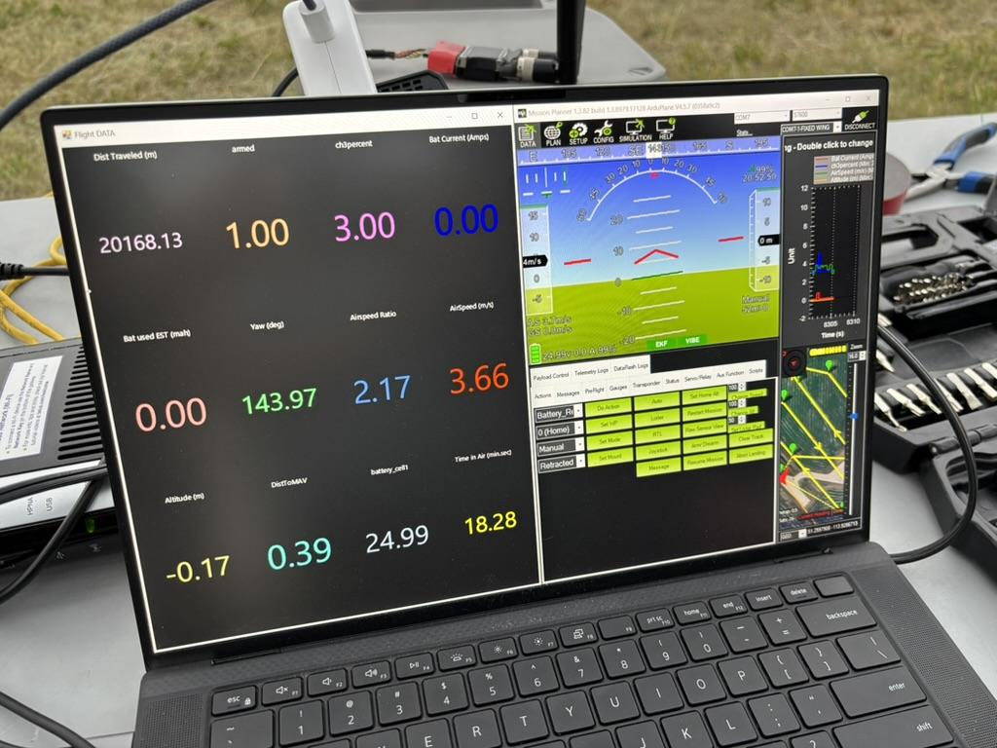
Mission Planner
Positives
Free
Mission planning
Visual data and real time graphing
Built in SITL for testing
Extensive documentation
Easy access to ArduPilot parameters
Cons
Steep learning curve
Customization is complicated
Mission planning limitations
Windows only
Outdated interface

Slide 26
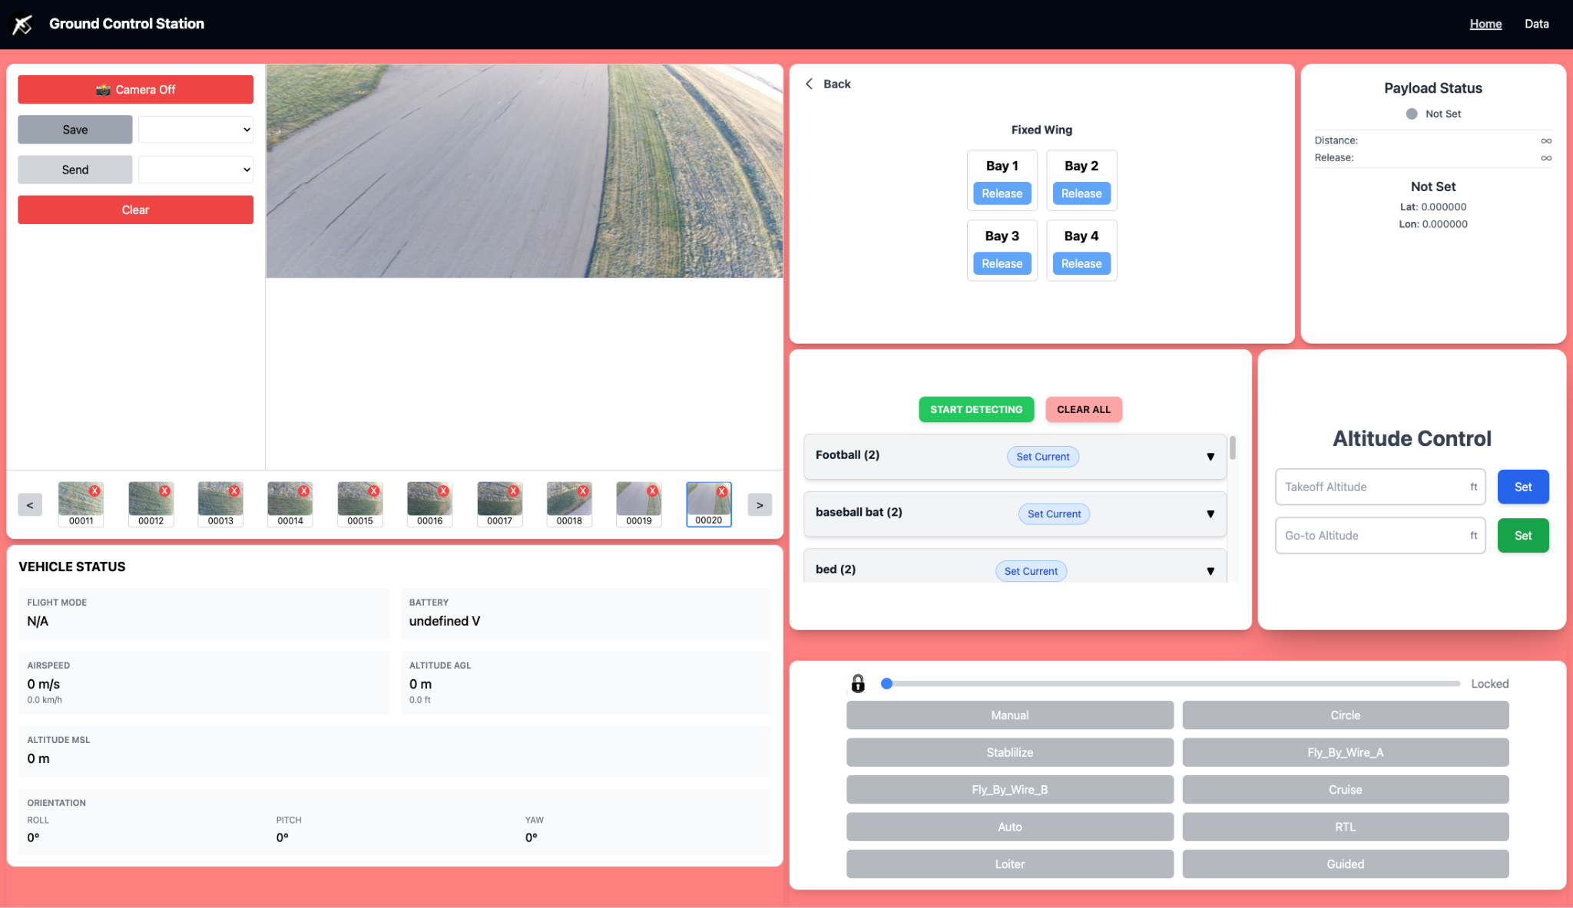
Custom Ground Control Station
Notes:
Our GCS uses a React frontend with a Flask + Python backend. We chose this stack because it’s common, front end looks good, reliable, and easy for our team which are students to work with.
The backend sends MAVLink commands directly to the aircraft, so we can see high-priority commands and reports like control flight modes, check system status, and adjust altitude easily.
We’ve also built custom features you which cannot be easily added or found in Mission Planner—like payload bay control, our own mapping algorithm, live payload status tracking, and a targeting algorithm for identifying mission objectives.

Slide 27
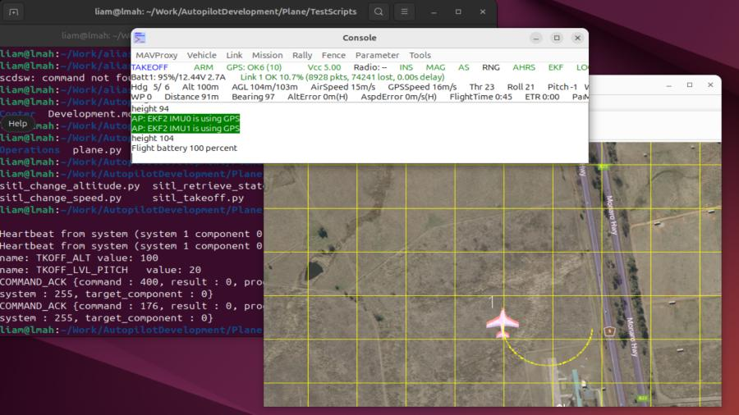
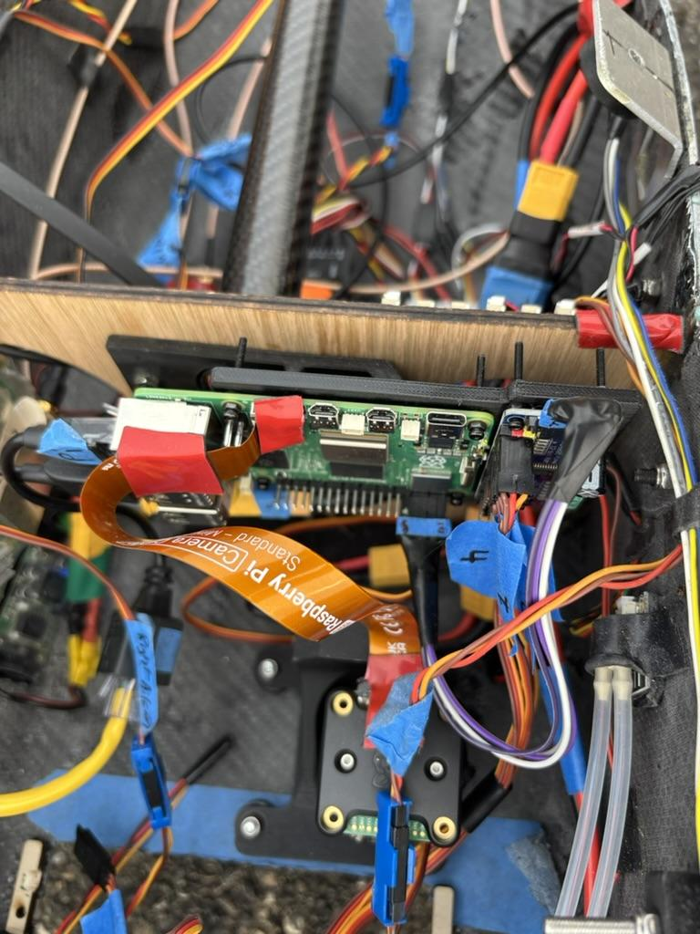



Flight Computer Software

Slide 28

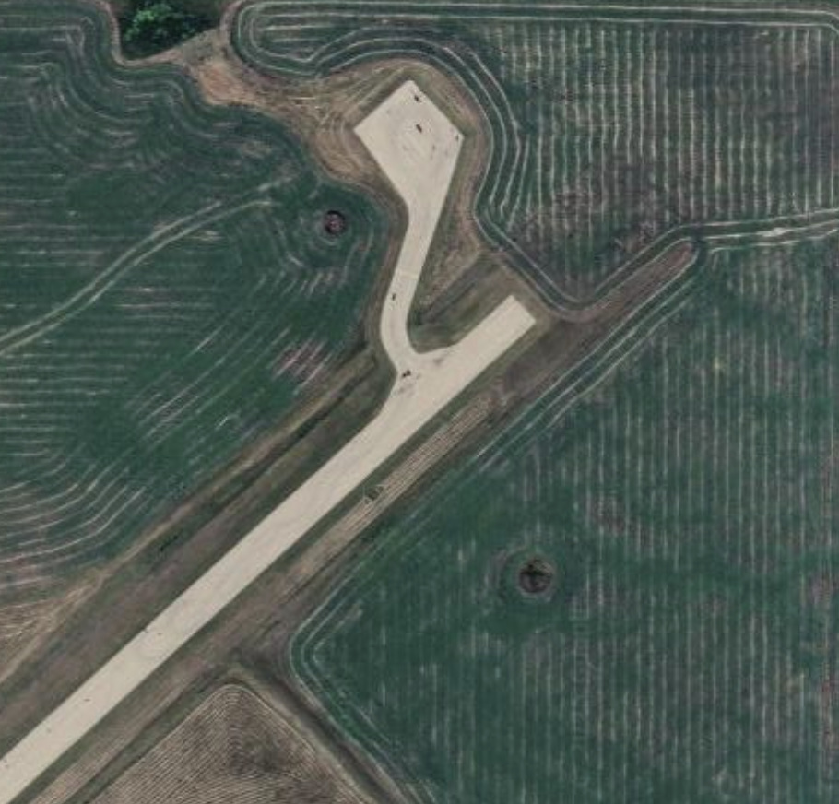
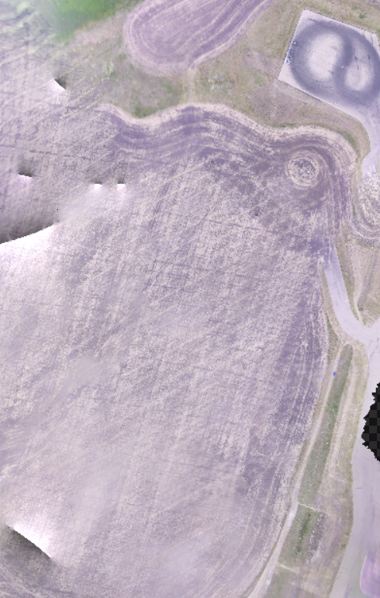
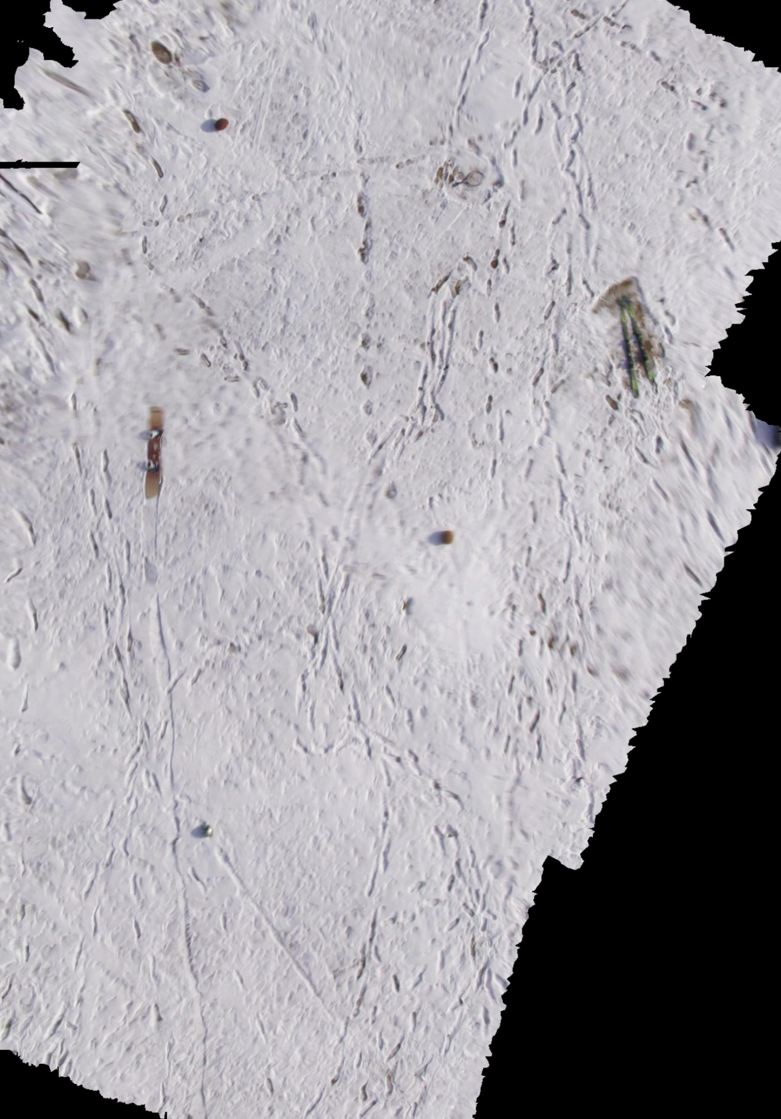
Mapping
Notes:
Bit of context for next few slides, for the competition there was 2 areas which could score points, one by creating a map which is judged based on its quality and the second is the accuracy of autonomous payload drpos
To do this we utilized OpenDroneMap, or ODM, which is an open-source drone imagery to generate our 2d maps as you can see on the second photo and third photo
One thing to note, because there is strict time constraints to process our images results before the end of the mission, we ran into issues where ODM was to slow. So we had to customize several ODM parameters to speed up the processing.

Slide 29
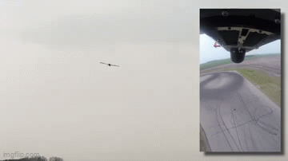




Autonomous Payload Drops
Notes:
Autonomous payload drops depend on successfully integrating multiple systems together:
Aircraft must fly autonomously
Payload must work
custom gcs must operate correctly
Mapping system must identify the target
GCS must capable of uploading a mission
The system is only as strong as its weakest link and a successful autonomous drops require integration of all these components to be working perfectly .
Our payload drop algorithm uses a three-waypoint mission with various waypoint actions which is uploaded by our custom gcs:
example of custom mission ( use board as an example ) choose a 3 waypoint mission for a few reasons
Waypoint 1: a few actions occur when the waypoint is hit, Slows acts as a way to reduce speed and decrese the altitude to improve drop accuracy and orients it toward the target waypoint
Waypoint 2: Target object identified by our targeting algorithm; with this being an waypoint, it allows our flight computer to monitor the distance and based on a configured
value drop the payload some amount of meters away. Also when the waypoint is hit a few actions occur such as speeding up the plane so it can loiter safley and increase its altitude
Waypoint 3: Allows plane to speed up to reach a safe speed and loiters waiting further commands

Slide 30

Schulich UAV
Challenges
Notes:
Alexey

Slide 31



Crash #1

Slide 32




Electronic Speed Controller (ESC)

Slide 33



Crash #2

Slide 34



Landing Gear

Slide 35


Slide 36




Autonomous Flight

Slide 37


Control Surface Jittering

Slide 38




Custom GCS Range Issues

Slide 39



Orca Before Competition
15+ successful flights
3 successful payload drops
Successfully mapped 30+ acres of land
Over 100km flown autonomously
Over 4 hours of flight time
2 major crashes

Slide 40






Competition

Slide 41

Competition Recap (HAZIQ PUT VIDEO HERE)

Slide 42



Questions? Thank you!
Design Deliverables: 1st
Team Website: 2nd
Design Report: 2nd
Mission Demonstration: 34th

